Slide 1


Introduction
Academic integrity & How to Avoid Plagiarism

Slide 2
Learning outcomes
Learning outcomes
To gain a better understanding of what plagiarism is and know how to avoid it, in particular, by:
  Referencing properly
  Developing good ways to paraphrase
  Taking good notes
For more information see: http://owll.massey.ac.nz/referencing/plagiarism.php
For information on academic integrity at Massey: http://www.massey.ac.nz/?a59cf3326e

Slide 3
What is it plagiarism?
What is it plagiarism?
Presenting the work of someone else, and saying it’s yours.
Plagiarism can apply to:
  The entire assignment
  Certain paragraphs
  Individual sentences

Slide 4
Plagiarism & Academic Integrity
Plagiarism & Academic Integrity
Plagiarism is part of academic integrity → being honest about your work
Includes not cheating in exams.

Slide 5




The plagiarism spectrum
Different types of plagiarism:
#1 Clone: Submitting another’s work, word for word, as one’s own
CTRL
+ C
#2 CTRL+C: Contains significant portions of text from a single source without alterations
#3 Find - Replace: Changing key words ans phrases but retaining the esential content of the source
#4 Remix: Paraphrases form multiple sources, made to fit together
#5 Recycle: Borrows generously from the writer's previous work without citation
For more info, see: https://www.turnitin.com/resources/plagiarism-spectrum-2-0
(Turnitin, 2016)

Slide 6
The Plagiarism Spectrum (continued…)
The Plagiarism Spectrum (continued…)
Different ways to plagiarise:
  Submitting an entire assignment that someone else has written.
  Copying and pasting paragraphs and sentences from somewhere else.
  Using your own work from a different essay.
Also different levels of intent
(Plagiarism spectrum from: Turnitin. (n.d). White paper: The plagiarism spectrum. Instructor insights into the 10 types of plagiarism. http://pages.turnitin.com/plagiarism_spectrum.html)

Slide 7
Turnitin
Turnitin
An online database used by some lecturers to match your assignment against journal articles, books and other assignments.
Turnitin produces an “originality report” indicating:
  Where text in an assignment matches other text already in Turnitin
  What the source is

Slide 8
Three scenarios
Three scenarios
What is and isn’t plagiarism?

Slide 9
Is this plagiarism? #1
Is this plagiarism? #1
#1: Sarah
Sarah was new to Massey. One of her friends, Emily, was a second year student who had completed the same paper the year before. As she was new and nervous about studying, Sarah asked Emily for help. Emily gave Sarah a copy of her essay for the same paper, and unknown to Emily, Sarah modelled her answer on it by copying large chunks of information.
Did Sarah plagiarise? Did Emily plagiarise?
(Write ‘yes’ or ‘no’ in chat)

Slide 10
The verdict #1
Sarah definitely plagiarized
But what about Emily?
Emily may also be penalized for collusion (students working together to deceive)

Slide 11
Penalty
Will range from a warning to receiving a zero mark, to being put on the University Academic Misconduct Register (AMR)
Emily could also be put on the AMR
BUT: Helping is not plagiarism.
It is OK for Emily to discuss the assignment with Sarah, clarify what is required, and help her formulate ideas.

Slide 12
Is this plagiarism? # 2
#2: Thomas
Thomas found a lot of information for his assignment online. He felt he was pushed for time, and wanted to do well, so he cut and pasted a lot of the description and details from various websites into his essay. He did say where he got his information (by using in-text citations), but he used exact sentences and paragraphs without putting them in his own words.
Is this plagiarism?
(Write ‘yes’ or ‘no’ in chat)

Slide 13
The verdict #2
Definitely plagiarism
  Information that is copied word for word from somewhere else must be placed in quotation marks
  It is preferable to paraphrase the information
  If using three words in a row from somewhere else, paraphrase or put in quotation marks
  Even when paraphrasing, cite the source

Slide 14
Is this plagiarism? # 3
#3: Taylor
Taylor wrote her essay based on the notes she had taken from different sources. She referenced some of the information, but couldn’t remember where she got it all from. When she was taking notes, she also mostly wrote down, word-for-word, what she had read, interspersed with a few comments of her own. When she submitted her essay to Turnitin, it came back with a high percentage of matches. Taylor was distraught.
Was this plagiarism?
(Write ‘yes’ or ‘no’ in chat)

Slide 15
The verdict #3
Yes. Inadvertent plagiarism is still plagiarism
  Taylor could have avoided this by taking better notes, so she knows which are her own words, and which are from other sources

Slide 16
Three ways to avoid plagiarism
Reference information correctly :
  When in doubt, cite sources
  Make it clear who said what
Paraphrase
  (use your own words to explain ideas)
Take good notes

Slide 17
Who said what?
Typically in-text citations in the body of your essay or report look like this:
  According to Smith (2011), the best source of…
  … was the case (Smith, 2011).
  According to Smith (2011), “the ultimate source is…” (p. 11).

Slide 18
When to provide a reference?
Whenever you use words, facts, ideas, theories, or interpretations from other sources:
  Copy exact words from book, journal articles, or other sources (quotation)
  Use an idea or fact from an outside source, even if you haven’t used their exact wording (paraphrasing/summarizing)
Exception: if information is widely known, and is not disputed by anyone

Slide 19
What is Paraphrasing?
“Paraphrasing means to restate information using different words” (OWLL, 2012)
When you use your own words to explain what someone else said

Slide 20
ways to paraphrase #1
First way
From a book or journal article that you want to re-write:
Read the passage and write down about three words/concepts or phrases.
Close the book or journal article.
Using those three words/concepts, re-write the information.
Go back to the book/journal article and compare what you’ve written to the original.
(Curtin University of Technology, 2011)

Slide 21
How to paraphrase example
Last of the big cats By Edward de la Billiere
Valmik Thapar is credited with almost single-handedly saving the tiger from being wiped out by poachers. But his fight to preserve this extraordinary predator is far from over. And the real threats now… are poverty, greed, and a lack of imagination.
Write down about three key words/concepts from the first sentence, and…
(Source: De la Billiere, E. (2012, October 17). The last of the big cats. The Guardian. http://www.guardian.co.uk/uk/2002/oct/17/animalwelfare.world)

Slide 22
Steps for paraphrasing – First way
Using three key words, try and re-write the information
Original: Valmik Thapar is credited with almost single-handedly saving the tiger from being wiped out by poachers.
My example:
Three concepts: Saving tigers, poachers, Valmik Thapar
Paraphrase:
Preventing tigers from becoming extinct from the actions of poachers has been a focus of Thapar’s work (de la Billiere, 2012).

Slide 23
ways to paraphrase #2
SECOND WAY
From a book or journal article that you want to re-write:
Use the author’s name in connection with the idea/s.
Flip the sentence on its head: change the order of the ideas in the sentence.
Choose alternative phrases or synonyms for key ideas.
Remember: Re-state the whole sentence; don’t just replace individual words

Slide 24
Give it a go
Last of the big cats By Edward de la Billiere
Valmik Thapar is credited with almost single-handedly saving the tiger from being wiped out by poachers. But his fight to preserve this extraordinary predator is far from over. And the real threats now… are poverty, greed, and a lack of imagination (de la Billiere, 2012).
Use the author’s name
Flip the sentence on its head
Choose some different words
Write down three key words / concepts
Re-write the information in your own words
OR

Slide 25
Using those paraphrasing methods
Using those paraprashing methods…
Original: And the real threats now … are poverty, greed, and a lack of imagination (de la Billiere, 2012).
My paraphrase example: …
As stated by de la Billiere (2012) greed, poverty, and an unwillingness to seek new solutions are the three threats to the survival of the tiger.

Slide 26
When paraphrasing…
Read enough of the text:
  To ensure you do not take something out of context
  Compare to the original to ensure that you have paraphrased the sentence sufficiently, and
  When using 3 or more words from the original, make sure to put double quote marks around them (e.g. “greed, poverty, and lack of imagination”)

Slide 27
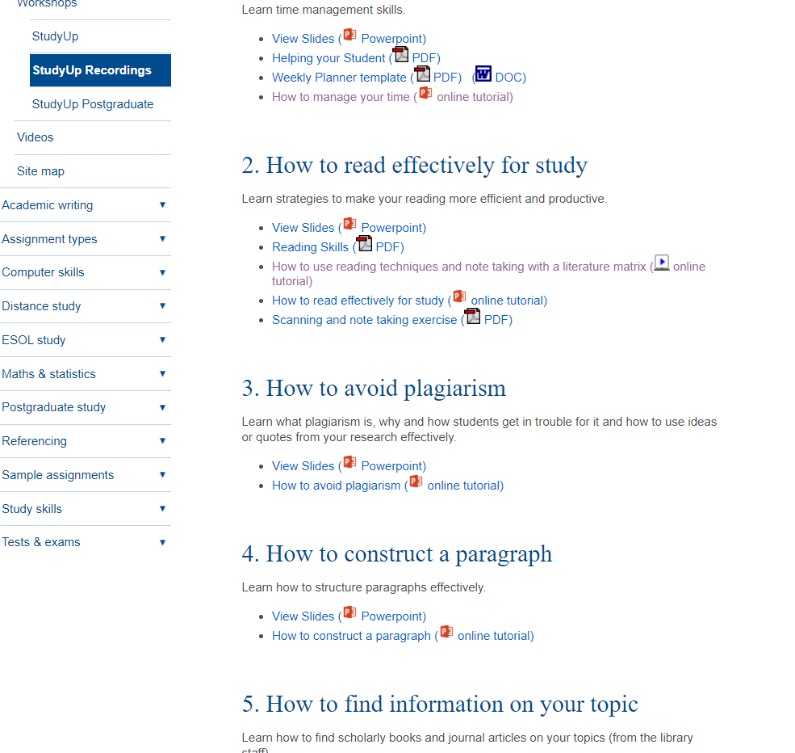
The Study Up Resource webpage
https://owll.massey.ac.nz/about-OWLL/studyup-resources.php

Slide 28
Top tips for note taking
#1 : Include full reference details of the article/book you’re reading
#2 : Write the page number down each time you take notes from different
pages of the same source
#3 : When copying direct quotes consider making them stand out in
your notes
#4 : Use a system to manage your reading material (e.g., folder, endnote
software, online management, digital note-taking software)

Slide 29
Summary
  Plagiarism is:
  Presenting the work of someone else, and saying it’s yours
  Avoid accidental plagiarism by:
  Referencing properly
  Developing good ways to paraphrase
  Taking good notes

Slide 30
Centre for learner success
Need help? We have a range of free services to help you with your assignment writing and study skills
Individual Support: Want to discuss your assignment before you hand it in? Want to discuss study skills (e.g. how to manage time)? See next slide for booking information.
Pre-Reading Service: Submit a draft assignment and receive individual written feedback on your assignment’s structure, focus, referencing, and use of sources. This service is available to first year internal and all distance students. You can access the forum through the Academic Writing and Learning Support site on your Stream homepage.
Workshops: Seminars and workshops are run on campus and online, which can help you with writing and study skills, such as essay writing, referencing, and writing research proposals. See here for programmes and registration details. See http://owll.massey.ac.nz/about-OWLL/workshops.php
Academic Q+A forum: Ask our consultants a question about academic writing and/or study skills. The Q & A forum is a place for students to receive help with quick, study-related questions. You can access the forum through the Academic Writing and Learning Support site on your Stream homepage.
OWLL: Information about academic writing and study skills, including assignment planning, essays, reports, and referencing. Go to http://owll.massey.ac.nz/index.php
Disability Services: A range of services and support for students who have health and disability issues that are impacting their study.
Pasifika@Massey: Whether studying as an internal or distance student, you can also access Learning support from the Pasifika Learning Advisors.
Te Rau Tauawhi: Ko tä Te Rau Tauawhi he äwhina i ngä tauira Mäori ki te tuku aromatawatai ki Te Reo Mäori, ki te tautoko hoki i ngä ähuatanga whakarite tuhinga. The Te Rau Tauawhi Mäori Student Centre can help you to submit your assignment in Te Reo Mäori and provide general assignment structure support.

Slide 31
Contact information
Massey university
Centre for learner success
CAMPUS LOCATIONS:
Palmerston North - Manawatu: Centre for Learner Success
Student Centre Level 2, Manawatu Campus
Albany: Centre for Learner Success
Level 3, Library, Albany Campus
Wellington: Centre for Learner Success
Block 5, Ground Floor (Level A in the Library), Wellington Campus
Phone: + 64 6 951 6540
Email: learnersuccess@massey.ac.nz
We help students with…
Assignment writing advice
Academic writing development
Understanding assignment questions
Citing and writing references
Enhancing study skills, like:
  Reading techniques
  Notetaking
  Time management skills
  Critical thinking, reading & writing
TO BOOK AN APPOINTMENT,
GO TO:
https://massey-nz.libcal.com/

