Slide 1
How to prepare for an exam
For more information, please see:
Cottrell, S. (2007). The exam skills handbook. Palgrave Macmillan, and
OWLL - http://owll.massey.ac.nz/main/tests-and-exams.php

Slide 2
Learning Outcomes
By the end of this session you will be able to:
Plan your study time
Gather key info to help you plan and revise
Summarise key material
Use memory systems to memorise sets of facts
Notes:
The session has two main aims: focusing of the importance of associations to improve learning and recall, and
How to build on associations through memory systems to memorise sets of facts.

Slide 3
Exam experiences
How do you feel about taking exams?
The thought of sitting an exam can be very stressful!
But there are great preparation strategies that will:
Reduce your stress
Help you remember more

Slide 4
The purpose of an exam
For you to demonstrate how much you have learnt about the subject/paper
You will want to:
know and use the terminology/concepts of the paper
name major theorists and what impact their theories have had
have good examples
have practised every which way a formula/equation can be applied
You will want to demonstrate your knowledge, understanding and ability to apply and evaluate the concepts

Slide 5
Preparation makes perfect
Step 1: Plan your study time
Step 2: Collect information
Step 3: Summarise information
Step 4: Memorise and revise

Slide 6
Step 1. Planning study time
Get organised and plan your study time:
Use a wall planner
Use a timetable

Slide 7
Step 1. Planning study time
Get organised and plan your study time:
Write down exam dates (wall planner)
Decide on the amount of time needed to study for each exam
Think about where you will study

Slide 8
Step 1. Planning study time
Get organised and plan your study time:
Block out study times (timetable)
Remember to factor in regular breaks
Break each session into topics that you will study and practise
Review study timetable every week

Slide 9
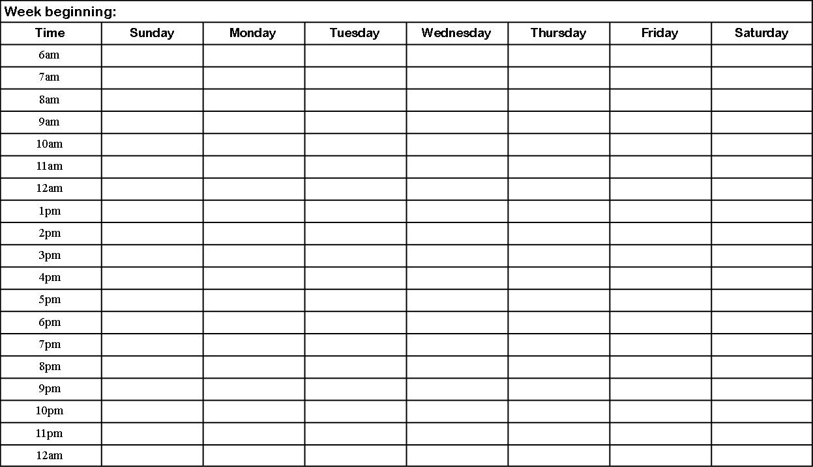
Step 1. Planning study time
STUDY: (home)
Make flash cards for module two, 115.118
STUDY: (library)
Go through 172.108 exams and practice formulas
Make flash cards for module one, 172.108
Paid work
Paid work
STUDY: (library) Gather previous exams
Make flash cards for module one, 115.118
Touch rugby
Swimming
STUDY: (home) Revise study schedule for next week

Slide 10
Step 1. Planning study time
Know when (and where) your exams are, and when and where you will study for them.
Work early or work late – find the best place and time for you. While studying, remember to eat, sleep and get regular exercise.

Slide 11
Step 2. Collect information
You will be tested on the themes you were taught each week.
Go back to your lecture notes
Go back to key readings
Look at the notes you made each week
Look at past exams – what sorts of questions might you be asked about different topics?

Slide 12
Step 2. Collect information
Previous exams
You want to:
Identify themes
Become familiar with how questions are asked
Know what types of questions are asked
Multiple choice
Short answer
Essays
Some exams have all three

Slide 13
Step 2. Collect information
Previous exams: Time allocation
You want to be able to answer all the compulsory questions in the allocated time
Good idea to work this out in advance
Will still need to remind yourself on the day
How long will you spend on each question?
One way is to turn the marks the section is worth into the percentage of time you’ll spend (e.g., for a section worth 60 marks out of 100 total for the exam, spend 60% of your time)
But remember that multiple choice often take less time, and another option is to allocate 1 minute for each question.

Slide 14
Preparation makes perfect
Recap
Plan your study time
Gather your information
Now
Reduce your information (summarising)
Use memory strategies
Revise revise revise

Slide 15
Step 3. Summarise information
Reduce your information
Make connections between the information
If the information doesn’t make sense to you, it will be harder to remember
Organise your information
Number it
Break it into sections
Label it
List it

Slide 16
Study summaries
Different ways to reduce your information
Condense information into:
Flash Cards
Note cards
Audio Recordings
Charts
Mindmaps

Slide 17
Outline summary / linear notes
172.237
A Global Perspective on English – Topic 3
Global Varieties of Eng. Lang. Kachru & Nelson (2001 pp. 14-15)
Inner Circle
USA, UK, Canada, NZ, Aus - last 3 controversial p. 10
All public functions > Eng.
gov; media, creative pursuits; edu.
Outer Circle
India, Pakistan, Nigeria, Singapore, South Africa, Zambia + others
See table Kachru & Nelson (2001, p. 11) for more egs of outer and inner countries
Long history as institutionalized lang. & has cultural role too
gov/edu.
Literary creativity / pop cul.

Slide 18
Charts
Especially good for planning compare and contrast questions
3 basic issues | Piaget | Vygotsky
Continuous or discontinuous development? | Discontinuous – stages of development | Continuous – gradually acquire skills
One course of development or many? | One – stages are universal | Many possible courses
Nature or nurture most important? | Both nature and nurture | Both nature and nurture

Slide 19
Example of a study matrix
Group Name | Reproduction | O₂ Relation | Habitat | Morphology | Covering | Get Energy | Host Relation
Archybacteria Methanoger | RNA | Ob. Anaero | Swamp/ marsh endobiotic | Solitary | Unique Membrane Lack paptidoglycin | H₂ + CO₂ ➔ CH₄ + H₂O | Few(-) & many(+)
Halophile
Thermacidophile
Bacteria Janobacteria
Notorophic
Pseudonomads
Spriochaetes
Endosphere Formers
Displays similarities and differences of bacteria

Slide 20
Example of a diagram / mindmap
Therapeutic Management
& Complications
Pain Management
Paracetamol
Oral Morphine
M-ESLON
SEVREDOL
Codine
Infection
Antibiotics
Clinical Features
Clinical Manifestations
(symptoms)
Redness
Oedema
Tenderness
Actual visable ulcer
Broken skin area
(ROTAB)
ULCERS
Causes
Bed bound for long periods
Not turning patients
Diabetes
Vascular issues
Nursing Considerations
Assessment
Action

Slide 21
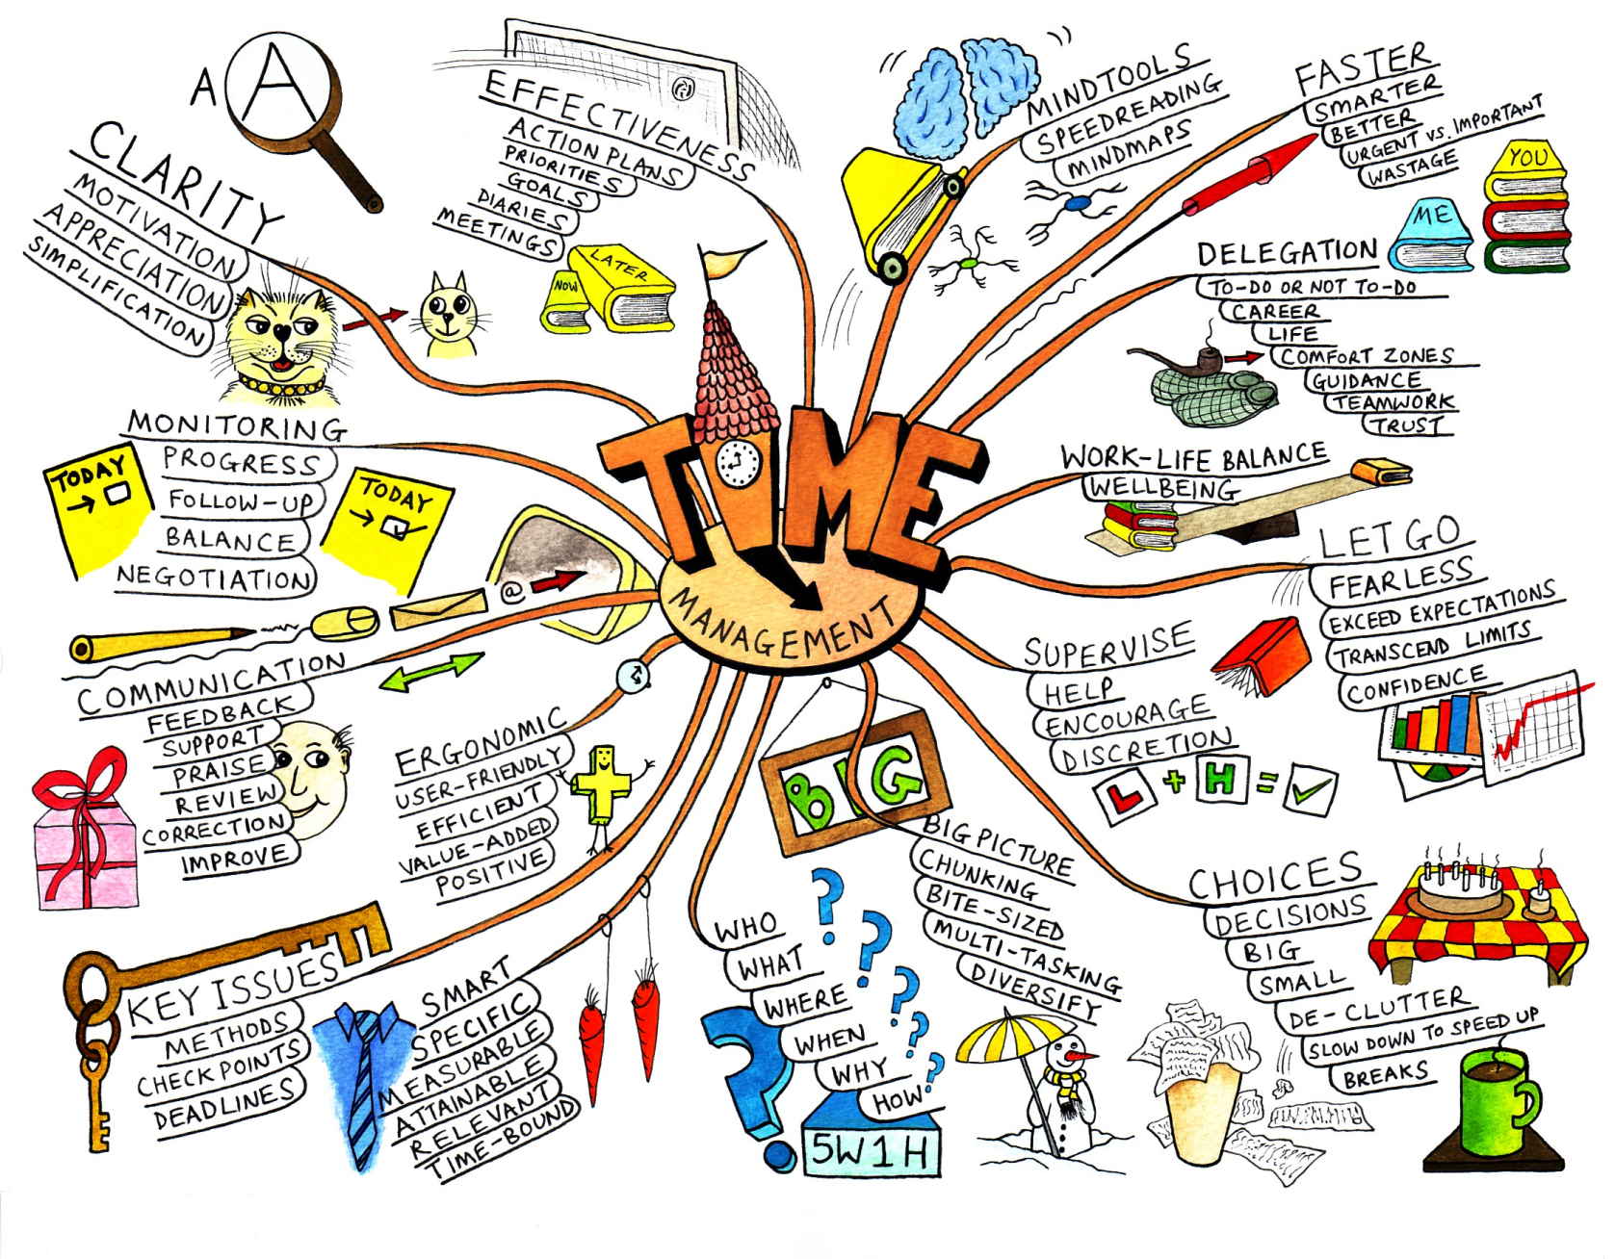
Mindmap example
From the Mind Tools website:
http://www.mindtools.com/media/
Diagrams/mindmap.jpg

Slide 22
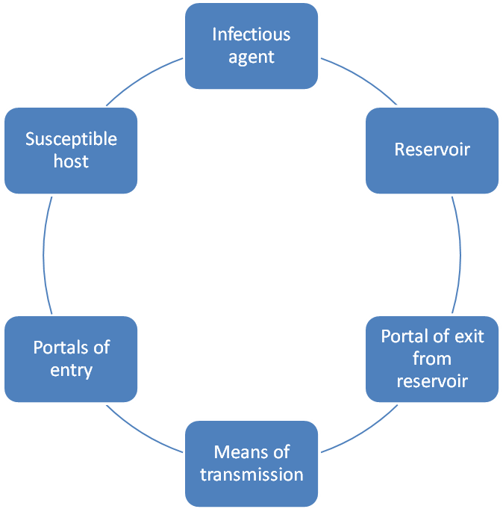
Flowchart example

Slide 23
Step 4. Memorise and revise
Memory strategies
Acronyms and acrostics
Talking out loud
Chunking
Rhymes and sayings/chants
Roman room

Slide 24
Two memory special effects
Two memory special effects
“Startle effect”
If something stands out as ODD, bizarre or unexpected it can sometimes be easier to remember
“People effect”
Faces are memorable, especially famous faces
Imagine your favourite musician / pop idol / TV character etc. explaining your subject

Slide 25
Two memory special effects
Acronyms and acrostics
Use these to remember a set or a sequence
BEDMAS –
Brackets,
Exponentials,
Division,
Multiplication,
Addition,
Subtraction
Every good boy deserves fruit
Happy Henry likes beans, butter, carrots, nuts or fruit now

Slide 26
Two memory special effects
Rhymes
Great for definitions – writing them yourself will help your understanding
Physics:
Boyles' Law: At constant temperature, pressure is inversely proportional to volume. Boyle's law is best of all because it presses gasses awfully small.
Politics:
Bipartisan: a situation where the normally opposing political parties come together to agree on an initiative.
Whatever the weather they party together.

Slide 27
Two memory special effects
Encoding and recounting
Talk out loud
Go through a topic out loud
How fluent is your explanation? Did you have to stop and start?
Are you using the right terms or having to use less clear, less precise words?
Can also read notes out loud.
Chunking
Great for numbers and formulas
0800 83 83 83

Slide 28
You try!
How would you try to remember this list?
Oranges
Arteries
Sun
Chocolate
Veins
Limes
Horse
Capillaries
Lemons
You might group them into categories:
Blood vessels: arteries, veins, capillaries
Citrus fruit: oranges, lemons, limes
You might come up with a story: the sun melted the chocolate and the horse licked it up.
You might come up with a rhyme, an acronym, or a visual image…

Slide 29
Summary
Overall, the key to good memory in exams is to encode your information in a way that works for you, and
revise, revise, revise!

Slide 30
Need help? We have a range of free services to help you with your assignment writing and study skills:
Individual Support: Want to discuss your assignment before you hand it in? Want to discuss study skills (e.g. how to manage time)? Book an appointment at https://massey-nz.libcal.com/
Pre-Reading Service: Submit a draft assignment and receive individual written feedback on your assignment’s structure, focus, referencing, and use of sources. This service is available to first year internal and all distance students. You can access the forum through the Academic Writing and Learning Support site on your Stream homepage.
Workshops: Seminars and workshops are run on campus and online, which can help you with writing and study skills, such as essay writing, referencing, and writing research proposals. See here for programmes and registration details. See http://owll.massey.ac.nz/about-OWLL/workshops.php
Academic Q+A forum: Ask our consultants a question about academic writing and/or study skills. The Q & A forum is a place for students to receive help with quick, study-related questions. You can access the forum through the Academic Writing and Learning Support site on your Stream homepage.
OWLL: Information about academic writing and study skills, including assignment planning, essays, reports, and referencing. Go to http://owll.massey.ac.nz/index.php
Disability Services: A range of services and support for students who have health and disability issues that are impacting their study.
Pacific Massey: Whether studying as an internal or distance student, you can also access Learning support from the Pasifika Learning Advisors.
Te Rau Tauawhi: Ko tā Te Rau Tauawhi he āwhina i ngā tauira Māori ki te tuku aromatawatai ki Te Reo Māori, ki te tautoko hoki i ngā āhuatanga whakarite tuhinga. The Te Rau Tauawhi Māori Student Centre can help you to submit your assignment in Te Reo Māori and provide general assignment structure support.

Slide 31
The Centre for Learner Success
We help students with…
Assignment writing advice
Academic writing development
Understanding assignment questions
Citing and writing references
Enhancing study skills, like:
Reading techniques
Notetaking
Time management skills
Critical thinking, reading & writing
Campus locations
Palmerston North – Manawatū Student Centre Level 2, Manawatū Campus
+ 64 6 951 6540
learnersuccess@massey.ac.nz
Albany Level 3, Library, Albany Campus + 64 9 212 7117
learnersuccess@massey.ac.nz
Wellington Block 5, Ground Floor (Level A in the Library), Wellington Campus +64 4 801 5799 extn: 63389
learnersuccess@massey.ac.nz
TO BOOK AN APPOINTMENT,
GO TO:
https://massey-nz.libcal.com/

