Slide 1
Academic integrity and how to avoid plagiarism
For more information see: http://owll.massey.ac.nz/referencing/plagiarism.php
For information on academic integrity at Massey: http://www.massey.ac.nz/?a59cf3326e

Slide 2
Learning Outcomes
To gain a better understanding of what plagiarism is and know how to avoid it, in particular, by:
Referencing properly
Developing good ways to paraphrase
Taking good notes
Notes:
The session has two main aims: focusing of the importance of associations to improve learning and recall, and
How to build on associations through memory systems to memorise sets of facts.

Slide 3
What plagiarism is
Presenting the work of someone else, and saying it’s yours.
Plagiarism can apply to:
The entire assignment
Certain paragraphs
Individual sentences
Notes:
The session has two main aims: focusing of the importance of associations to improve learning and recall, and
How to build on associations through memory systems to memorise sets of facts.

Slide 4
Plagiarism and academic integrity
Plagiarism is part of academic integrity → being honest about your work
Includes not cheating in exams.
Notes:
The session has two main aims: focusing of the importance of associations to improve learning and recall, and
How to build on associations through memory systems to memorise sets of facts.

Slide 5
The plagiarism spectrum
Different types of plagiarism:
#1 Clone: Submitting another’s work, word for word, as one’s own
CTRL
+ C
#2 CTRL+C: Contains significant portions of text from a single source without alterations
#3 Find + Replace: Changing key words and phrases but retaining the essential content of the source
#4 Remix: Paraphrases from multiple sources, made to fit together
#5 Recycle: Borrows generously from the writer's previous work without citation (aka. Self-plagiarism)
For more info, see: https://www.turnitin.com/static/plagiarism-spectrum/
(Turnitin, 2016)
Notes:
The session has two main aims: focusing of the importance of associations to improve learning and recall, and
How to build on associations through memory systems to memorise sets of facts.

Slide 6
Plagiarism and academic integrity
Many different ways to plagiarise
Also different levels of intent
For more info, see: Turnitin. (n.d). The plagiarism spectrum 2.0. https://www.turnitin.com/resources/plagiarism-spectrum-2-0
Notes:
The session has two main aims: focusing of the importance of associations to improve learning and recall, and
How to build on associations through memory systems to memorise sets of facts.

Slide 7
Turnitin
An online database used by many lecturers to match your assignment against journal articles, books, and other assignments.
Turnitin produces an “originality report” indicating:
Where text in an assignment matches other text already in Turnitin
What the source is
Notes:
The session has two main aims: focusing of the importance of associations to improve learning and recall, and
How to build on associations through memory systems to memorise sets of facts.

Slide 8
Three scenarios
What is and isn’t plagiarism?
Notes:
The session has two main aims: focusing of the importance of associations to improve learning and recall, and
How to build on associations through memory systems to memorise sets of facts.

Slide 9
Scenario #1: Sarah
Sarah was new to Massey. One of her friends, Emily, was a second year student who had completed the same paper the year before. As she was new and nervous about studying, Sarah asked Emily for help. Emily gave Sarah a copy of her essay for the same paper, and unknown to Emily, Sarah modelled her answer on it by copying large chunks of information.
Did Sarah plagiarise?
Did Emily plagiarise?
(Write ‘yes’ or ‘no’ in chat)
Notes:
The session has two main aims: focusing of the importance of associations to improve learning and recall, and
How to build on associations through memory systems to memorise sets of facts.

Slide 10
Scenario #1: Verdict
Sarah definitely plagiarised
But what about Emily?
Emily may also be penalised for collusion (students working together to deceive)
Notes:
The session has two main aims: focusing of the importance of associations to improve learning and recall, and
How to build on associations through memory systems to memorise sets of facts.

Slide 11
Scenario #1: Penalty
Will range from a warning to receiving a zero mark, to being put on the University Academic Misconduct Register (AMR)
Emily could also be put on the AMR
BUT: Helping is not plagiarism.
It is OK for Emily to discuss the assignment with Sarah, clarify what is required, and help her formulate ideas.
Notes:
The session has two main aims: focusing of the importance of associations to improve learning and recall, and
How to build on associations through memory systems to memorise sets of facts.

Slide 12
Scenario #2: Thomas
Thomas found a lot of information for his assignment online. He felt he was pushed for time, and wanted to do well, so he cut and pasted a lot of the description and details from various websites into his essay. He did say where he got his information (by using in-text citations), but he used exact sentences and paragraphs without putting them in his own words.
Is this plagiarism?
(Write ‘yes’ or ‘no’ in chat)
Notes:
The session has two main aims: focusing of the importance of associations to improve learning and recall, and
How to build on associations through memory systems to memorise sets of facts.

Slide 13
Scenario #2: Verdict
Definitely plagiarism
Information that is copied word for word from somewhere else must be placed in quotation marks
It is preferable to paraphrase the information
If using three words in a row from somewhere else, paraphrase or put in quotation marks
Even when paraphrasing, cite the source
Notes:
The session has two main aims: focusing of the importance of associations to improve learning and recall, and
How to build on associations through memory systems to memorise sets of facts.

Slide 14
Scenario #3: Taylor
Taylor wrote her essay based on the notes she had taken from different sources. She referenced some of the information, but couldn’t remember where she got it all from. When she was taking notes, she also mostly wrote down, word-for-word, what she had read, interspersed with a few comments of her own. When she submitted her essay to Turnitin, it came back with a high percentage of matches. Taylor was distraught.
Was this plagiarism?
(Write ‘yes’ or ‘no’ in chat)
Notes:
The session has two main aims: focusing of the importance of associations to improve learning and recall, and
How to build on associations through memory systems to memorise sets of facts.

Slide 15
Scenario #3: Verdict
Yes. Inadvertent plagiarism is still plagiarism
Taylor could have avoided this by taking better notes, so she knows which are her own words, and which are from other sources
Notes:
The session has two main aims: focusing of the importance of associations to improve learning and recall, and
How to build on associations through memory systems to memorise sets of facts.

Slide 16
Three ways to avoid plagiarism
Reference information correctly:
When in doubt, cite sources
Make it clear who said what
Paraphrase
(use your own words to explain ideas)
Take good notes
Notes:
The session has two main aims: focusing of the importance of associations to improve learning and recall, and
How to build on associations through memory systems to memorise sets of facts.

Slide 17
Who said what?
Typically in-text citations in the body of your essay or report look like this:
According to Smith (2011), the best source of…
… was the case (Smith, 2011).
According to Smith (2011), “the ultimate source is…” (p. 11).
For referencing guidance, check out the upcoming ‘How to Reference’ session & APA Interactive
Notes:
The session has two main aims: focusing of the importance of associations to improve learning and recall, and
How to build on associations through memory systems to memorise sets of facts.

Slide 18
When to provide a reference
Whenever you use words, facts, ideas, theories, or interpretations from other sources:
Copy exact words from book, journal articles, or other sources (quotation)
Use an idea or fact from an outside source, even if you haven’t used their exact wording (paraphrasing/summarizing)
Exception: if information is widely known, and is not disputed by anyone
Notes:
The session has two main aims: focusing of the importance of associations to improve learning and recall, and
How to build on associations through memory systems to memorise sets of facts.

Slide 19
What is paraphrasing?
“Paraphrasing means to restate information using different words” (OWLL, 2012)
Using your own words to explain what someone else said
Notes:
The session has two main aims: focusing of the importance of associations to improve learning and recall, and
How to build on associations through memory systems to memorise sets of facts.

Slide 20
Ways to paraphrase: #1
From a book or journal article that you want to re-write:
Read the passage and write down about three words/concepts or phrases.
Close the book or journal article.
Using those three words/concepts, re-write the information.
Go back to the book/journal article and compare what you’ve written to the original.
(Curtin University of Technology, 2011)
Notes:
The session has two main aims: focusing of the importance of associations to improve learning and recall, and
How to build on associations through memory systems to memorise sets of facts.

Slide 21
How to paraphrase: Example
Last of the big cats By Edward de la Billiere
Valmik Thapar is credited with almost single-handedly saving the tiger from being wiped out by poachers. But his fight to preserve this extraordinary predator is far from over. And the real threats now… are poverty, greed, and a lack of imagination.
Write down about three key words/concepts from the first sentence, and…
(Source: De la Billiere, E. (2012, October 17). The last of the big cats. The Guardian. http://www.guardian.co.uk/uk/2002/oct/17/animalwelfare.world)
Notes:
The session has two main aims: focusing of the importance of associations to improve learning and recall, and
How to build on associations through memory systems to memorise sets of facts.

Slide 22
How to paraphrase: Example
Using three key words, try and re-write the information
Original: Valmik Thapar is credited with almost single-handedly saving the tiger from being wiped out by poachers.
My example:
Three concepts: Saving tigers, poachers, Valmik Thapar
Paraphrase:
Preventing tigers from becoming extinct from the actions of poachers has been a focus of Thapar’s work (de la Billiere, 2012).
(Source: De la Billiere, E. (2012, October 17). The last of the big cats. The Guardian. http://www.guardian.co.uk/uk/2002/oct/17/animalwelfare.world)
Notes:
The session has two main aims: focusing of the importance of associations to improve learning and recall, and
How to build on associations through memory systems to memorise sets of facts.

Slide 23
Ways to paraphrase: #2
From a book or journal article that you want to re-write:
Use the author’s name in connection with the idea/s.
Flip the sentence on its head: change the order of the ideas in the sentence.
Choose alternative phrases or synonyms for key ideas.
Remember: Re-state the whole sentence; don’t just replace individual words
Notes:
The session has two main aims: focusing of the importance of associations to improve learning and recall, and
How to build on associations through memory systems to memorise sets of facts.

Slide 24
Give it a go
Valmik Thapar is credited with almost single-handedly saving the tiger from being wiped out by poachers. But his fight to preserve this extraordinary predator is far from over. And the real threats now… are poverty, greed, and a lack of imagination (de la Billiere, 2012).
Use the author’s name
Flip the sentence on its head
Choose some different words
Write down three key words / concepts
Re-write the information in your own words
OR
Notes:
The session has two main aims: focusing of the importance of associations to improve learning and recall, and
How to build on associations through memory systems to memorise sets of facts.

Slide 25
Give it a go
Original: And the real threats now … are poverty, greed, and a lack of imagination (de la Billiere, 2012).
My paraphrase example: …
As stated by de la Billiere (2012) greed, poverty, and an unwillingness to seek new solutions are the three threats to the survival of the tiger.
Notes:
The session has two main aims: focusing of the importance of associations to improve learning and recall, and
How to build on associations through memory systems to memorise sets of facts.

Slide 26
When paraphrasing …
Read enough of the text:
To ensure you do not take something out of context
Compare to the original to ensure that you have paraphrased the sentence sufficiently, and
When using 3 or more words from the original, make sure to put double quote marks around them (e.g. “greed, poverty, and lack of imagination”)
Notes:
The session has two main aims: focusing of the importance of associations to improve learning and recall, and
How to build on associations through memory systems to memorise sets of facts.

Slide 27
Note-taking: Top tips
#1 : Include full reference details of the article/book you’re reading
#2 : Write the page number down each time you take notes from different
pages of the same source
#3 : When copying direct quotes consider making them stand out in
your notes
#4 : Use a system to manage your reading material (e.g., folder, endnote
software, online management, digital note-taking software)
Notes:
The session has two main aims: focusing of the importance of associations to improve learning and recall, and
How to build on associations through memory systems to memorise sets of facts.

Slide 28
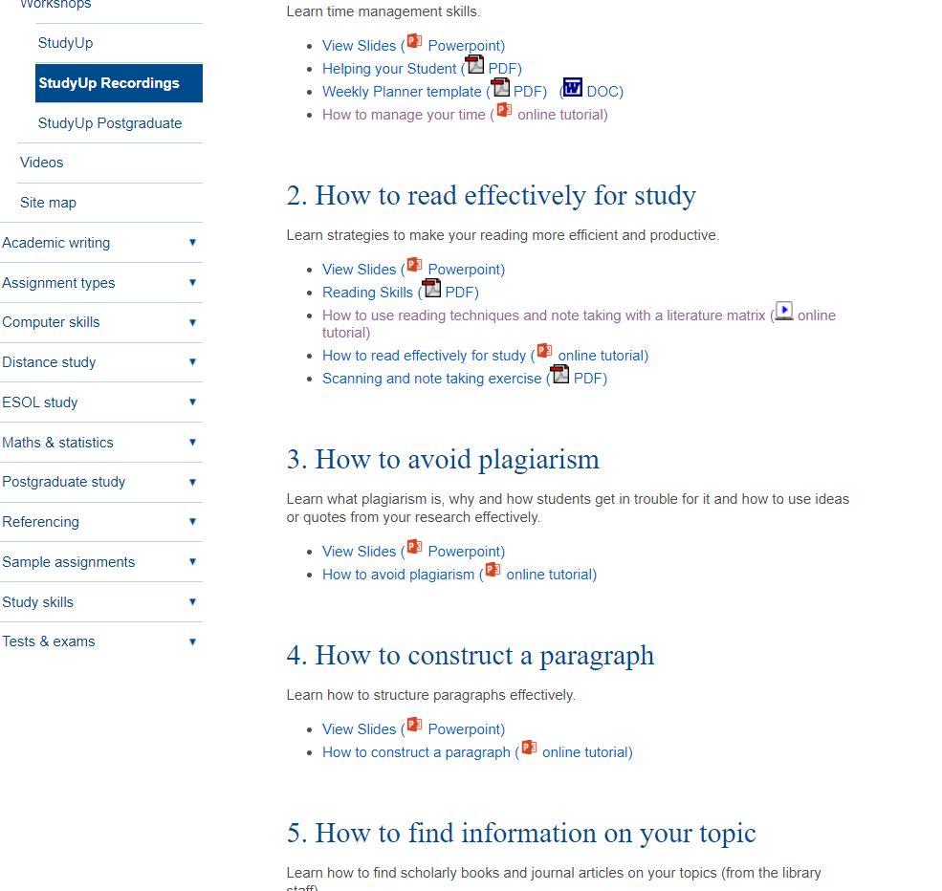
The Study Up Resource webpage
https://owll.massey.ac.nz/about-OWLL/studyup-resources.php
Notes:
The session has two main aims: focusing of the importance of associations to improve learning and recall, and
How to build on associations through memory systems to memorise sets of facts.

Slide 29
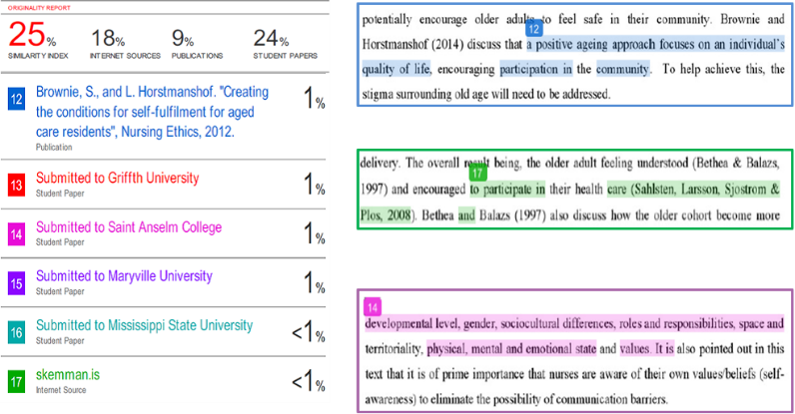
Using Turnitin reports to review writing
See: Submitting your assignment and generating a Turnitin report
Also: How to interpret your Turnitin report

Slide 30
Artificial Intelligence (AI)
Since the introduction of AI systems like Chat GPT and Dall E2, universities have had to give serious consideration to its potential effects on academia as a whole.
At present:
Unless explicitly directed to by your lecturer, it is best not to use AI.
However, grammar level AI (e.g. Grammarly) is usually okay.
Always be cautious citing sources generated by AI as sometimes it can create sources that do not exist. It is recommended you personally check all sources generated by AI tools.
You can find more up-to-date information on Massey’s webpages.
See: OWLL - ”Plagiarism”; Massey’s “Student Academic Integrity Policy (AB10/110)”
Notes:
The session has two main aims: focusing of the importance of associations to improve learning and recall, and
How to build on associations through memory systems to memorise sets of facts.

Slide 31
Summary
Plagiarism is:
Presenting the work of someone else, and saying it’s yours
Avoid accidental plagiarism by:
Referencing properly
Developing good ways to paraphrase
Taking good notes

Slide 32
Need help? We have a range of free services to help you with your assignment writing and study skills:
Individual Support: Want to discuss your assignment before you hand it in? Want to discuss study skills (e.g. how to manage time)? Book an appointment at https://massey-nz.libcal.com/
Pre-Reading Service: Submit a draft assignment and receive individual written feedback on your assignment’s structure, focus, referencing, and use of sources. This service is available to first year internal and all distance students. You can access the forum through the Academic Writing and Learning Support site on your Stream homepage.
Workshops: Seminars and workshops are run on campus and online, which can help you with writing and study skills, such as essay writing, referencing, and writing research proposals. See here for programmes and registration details. See http://owll.massey.ac.nz/about-OWLL/workshops.php
Academic Q+A forum: Ask our consultants a question about academic writing and/or study skills. The Q & A forum is a place for students to receive help with quick, study-related questions. You can access the forum through the Academic Writing and Learning Support site on your Stream homepage.
OWLL: Information about academic writing and study skills, including assignment planning, essays, reports, and referencing. Go to http://owll.massey.ac.nz/index.php
Disability Services: A range of services and support for students who have health and disability issues that are impacting their study.
Pacific Massey: Whether studying as an internal or distance student, you can also access Learning support from the Pasifika Learning Advisors.
Te Rau Tauawhi: Ko tā Te Rau Tauawhi he āwhina i ngā tauira Māori ki te tuku aromatawatai ki Te Reo Māori, ki te tautoko hoki i ngā āhuatanga whakarite tuhinga. The Te Rau Tauawhi Māori Student Centre can help you to submit your assignment in Te Reo Māori and provide general assignment structure support.

Slide 33
The Centre for Learner Success
We help students with…
Assignment writing advice
Academic writing development
Understanding assignment questions
Citing and writing references
Enhancing study skills, like:
Reading techniques
Notetaking
Time management skills
Critical thinking, reading & writing
Campus locations
Palmerston North – Manawatū Student Centre Level 2, Manawatū Campus
+ 64 6 951 6540
learnersuccess@massey.ac.nz
Albany Level 3, Library, Albany Campus + 64 9 212 7117
learnersuccess@massey.ac.nz
Wellington Block 5, Ground Floor (Level A in the Library), Wellington Campus +64 4 801 5799 extn: 63389
learnersuccess@massey.ac.nz
TO BOOK AN APPOINTMENT,
GO TO:
https://massey-nz.libcal.com/

Slide 34
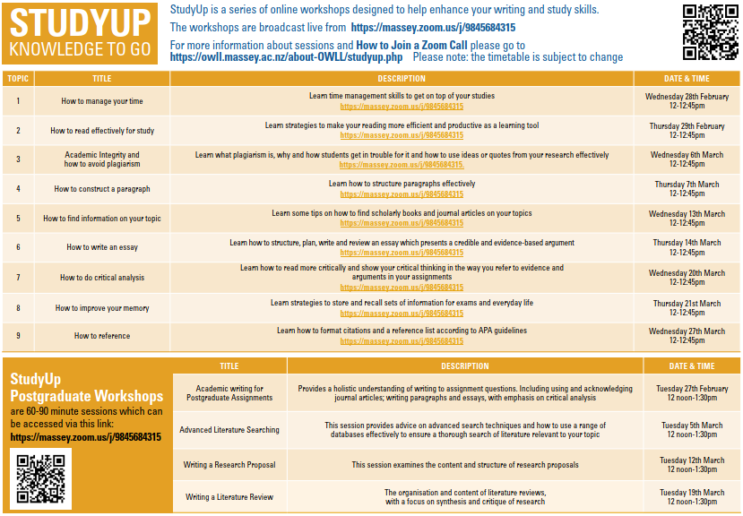
Register for Study Up HERE
See CLS’ workshop calendar HERE
Study Up Resources HERE

