Slide 1
How to improve your memory

Slide 2
LEARNING OUTCOMES
By the end of this session you will be able to:
Use associations to reinforce learning and recall
Use memory systems to memorize sets of facts

Slide 3
INTERACTIVE TASK 1
How many of these can you remember?
What you ate for lunch yesterday
An unpleasant experience at primary school
Where the washing powder is in your local supermarket
Your student ID number
The planets from the Sun outwards
Write:
The number of things you remember (e.g. 3)
Think about:
How you managed to recall some things
Why you remembered some things and not others

Slide 4
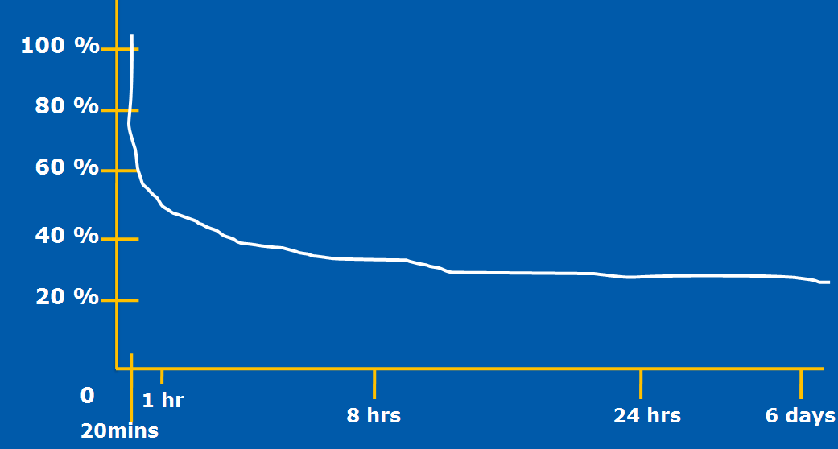
FEEDBACK
We remember information that had strong associations at the time we learnt it and / or is frequently used.
We are very good at forgetting in everyday life – and we carry that across into learning:
The Forgetting Curve (Ebbinghaus, 1913)
Notes:
Re-capping from the firs essays session.

Slide 5
One way to beat the forgetting curve is spaced recall – i.e. little and often
Another is to strengthen the associations you make when you first learn the information – that’s the main focus of the rest of this session
Notes:
Re-capping from the firs essays session.

Slide 6
PART 2: MAKING STRONGER ASSOCIATIONS
An association connects two things:
A target word or fact
This is unfamiliar information – and at Uni, usually abstract and / or technical – which you are trying to learn
A hook
This is something familiar – typically physical – that you can link to the target word or fact so that you can recall it later

Slide 7
An effective way to create a hook is through visualisation:
It is easier to remember pictures than words
The mind cannot distinguish between what is real and what is imaginary
Success is the result of recent, frequent and successful practice
Notes:
Re-capping from the firs essays session.

Slide 8
Steps to successful visualisation
Close your eyes
Relax
Create and manipulate sense impressions
Deepen and intensify
Suspend judgement
Practise often
Notes:
Re-capping from the firs essays session.

Slide 9
For example, in Human Development, you may need to remember the four stages of cognitive development proposed by Piaget:
Sensorimotor (birth to two years)
Preoperational (two to seven years)
Concrete operational (seven to eleven years)
Formal operational (eleven years onwards)
Notes:
Re-capping from the firs essays session.

Slide 10
An association can be a more familiar word that sounds like the target word.
For example, for ‘sensorimotor’, I might think of a motor car on a pile of coins.
Then, I close my eyes and visualise the ‘hook’ I’ve made.

Slide 11
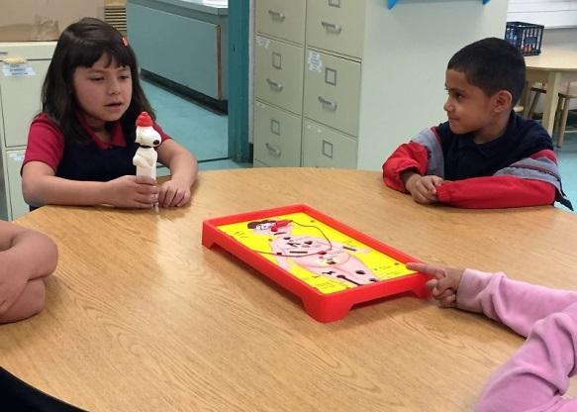
INTERACTIVE TASK 2
Write:
Your idea for a hook for the Piaget’s next stage:
Preoperational (two to seven years)
Feedback:
I thought of preschool kids playing the ‘Operation’ game

Slide 12
Part 3: LINKING YOUR ASSOCIATIONS
In academic studies, we often need to learn sets or sequences of words or facts
Examples include:
areas of the brain
components of the marketing mix conditions for a legal contract
Write:
One set or sequence of words or facts that it’s important to remember in a subject you are studying

Slide 13
There are a number of memory systems which can help you to remember sets or sequences of words or facts.
We will look at:
Acrostics
Stories
Loci (places)

Slide 14
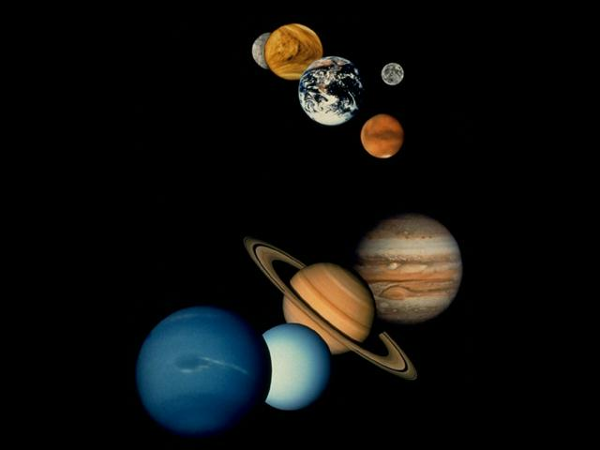
ACROSTICS
This is a simple system of making a sentence using the first letters of each word in a sequence.
On the left is the traditional one for the planets (including Pluto!):
Mercury Venus Earth Mars Jupiter Saturn Uranus Neptune Pluto
My Vehicle Encounters Many Jerks Struggling Up Neglected Paths
In this case, the ‘hooks’ are the words in the
sentence AND the sequence of the sentence itself.
Notes:
Re-capping from the firs essays session.

Slide 15
INTERACTIVE TASK 3
Write:
An acrostic for Piaget’s four stages of cognitive development:
Sensorimotor
Preoperational
Concrete operational
Formal operational
Feedback:
I came up with: Stages Piaget Cleverly Formulated

Slide 16
STORIES
This involves first making associations with words or facts and then making a story based on the original sequence. For example, if you need to memorise the most common elements (in order) found in rocks. The first step is to make a ‘hook’ for each item in the list:
oxygen = ox
silicon = Pamela Anderson
aluminium = aluminium foil
iron = clothes iron
calcium = calculator
sodium = can of soda water
potassium = pot
magnesium = magnet
Notes:
Re-capping from the firs essays session.

Slide 17
Then you make up a story (as absurd as you like) involving the ‘hooks’ in sequence.
ox: an ox is walking along the road
Anderson: riding the ox is Pamela Anderson
aluminium foil: she is wearing a dress made from aluminium foil
clothes iron: the dress is rumpled, so she starts ironing it
calculator: a calculator falls out of the dress pocket
soda water: it falls down and lands next to a can of soda water
pot: the can of soda water is in a large iron pot
magnet: stuck on the side of the pot is a huge magnet
Close your eyes and visualise the story as you say it – and go over it a few times till you recall it.
Notes:
Re-capping from the firs essays session.

Slide 18
LOCI (PLACES)
Instead of a story, you visualise each ‘hook’ in a particular place as you follow a familiar route in a fixed order. For instance:
Bed 3
Bed 2
Toilet
Bed 1
Bathroom
Back door
Dining Room
Garage
Kitchen
Lounge
Front door
Patio
Notes:
Re-capping from the firs essays session.

Slide 19
Let’s imagine you have to memorise the 12 cranial
nerves.
olfactory optic oculomotor trochlear
trigeminal abducens facial auditory
glossopharyngeal vagus spinal accessory hypoglossal
The first step is to create visual ‘hooks’. Write in the text box if any spring to mind.
Here are some we prepared earlier!
olfactory = oil factory facial = face
optic = optician auditory = audio tape
oculomotor = motor car glossopharyngeal = lipgloss
trochlear = truck vagus = veggies
trigeminal = three gems spinal accessory = spine
abducens = duck hypoglossal = hypodermic needle
Notes:
Re-capping from the firs essays session.

Slide 20
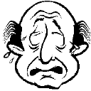
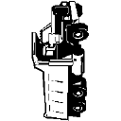
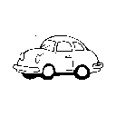
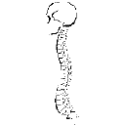
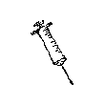
Then you visualise one in each room as you go
round the house.
Notes:
Re-capping from the firs essays session.

Slide 21
INTERACTIVE TASK 4
Write:
The second most common element found in rocks
The third Piagetian stage of cognitive development
The first cranial nerve
Feedback:
Silicon
Concrete operational
Olfactory

Slide 22
SUMMARY
In this session you have learnt how to:
Use associations to reinforce learning and recall
Use memory systems to memorize sets of facts

Slide 23
Need help? We have a range of free services to help you with your assignment writing and study skills
Individual Support: Want to discuss your assignment before you hand it in? Want to discuss study skills (e.g. how to manage time)? Book an appointment at massey.ac.nz/ctlcontacts or drop in.
Pre-Reading Service: Submit a draft assignment and receive individual written feedback on your assignment’s structure, focus, referencing, and use of sources. This service is available to first year internal and all distance students. You can access the forum through the Academic Writing and Learning Support site on your Stream homepage.
Workshops: Seminars and workshops are run on campus and online, which can help you with writing and study skills, such as essay writing, referencing, and writing research proposals. See here for programmes and registration details. See http://owll.massey.ac.nz/about-OWLL/workshops.php
Academic Q+A forum: Ask our consultants a question about academic writing and/or study skills. The Q & A forum is a place for students to receive help with quick, study-related questions. You can access the forum through the Academic Writing and Learning Support site on your Stream homepage.
OWLL: Information about academic writing and study skills, including assignment planning, essays, reports, and referencing. Go to http://owll.massey.ac.nz/index.php
Disability Services: A range of services and support for students who have health and disability issues that are impacting their study.
Pasifika@Massey: Whether studying as an internal or distance student, you can also access Learning support from the Pasifika Learning Advisors.
Te Rau Tauawhi: Ko tä Te Rau Tauawhi he äwhina i ngä tauira Mäori ki te tuku aromatawatai ki Te Reo Mäori, ki te tautoko hoki i ngä ähuatanga whakarite tuhinga. The Te Rau Tauawhi Mäori Student Centre can help you to submit your assignment in Te Reo Mäori and provide general assignment structure support.
ctl.massey.ac.nz

