Slide 1


How to improve your memory

Slide 2
Learning Outcomes
By the end of this session you will be able to:
Use associations to reinforce learning and recall
Use memory systems to memorise sets of facts
Notes:
The session has two main aims: focusing of the importance of associations to improve learning and recall, and
How to build on associations through memory systems to memorise sets of facts.

Slide 3
Memory test
How many of these can you remember?
What you ate for lunch yesterday
An unpleasant experience at primary school
Where the washing powder is in your local supermarket
Your student ID number
The planets from the Sun outwards
Write in the chat box:
The number of things you remember (e.g. 3)
Also:
Why do we manage to recall some things easily and not others?
Notes:
Memory test – how many of these things do you remember?
Also think about … Why do we manage to recall some things easily and not others?
Planets from the sun outwards are:
Mercury 2. Venus 3. Earth 4. Mars 5. Jupiter 6. Saturn 7. Uranus 8. Neptune (See acrostic on Slide 14)
Then Pluto – demoted to dwarf planet status in 1999.
Fun fact: Scientists belive there is a ninth planet nine. However, it is not yet visible to us, but it’s existence has been inferred by the orbital rotation of other planets. As such, it is thought to be a behemoth world. See: https://www.space.com/31671-planet-nine-discovery-explained-infographic.html

Slide 4
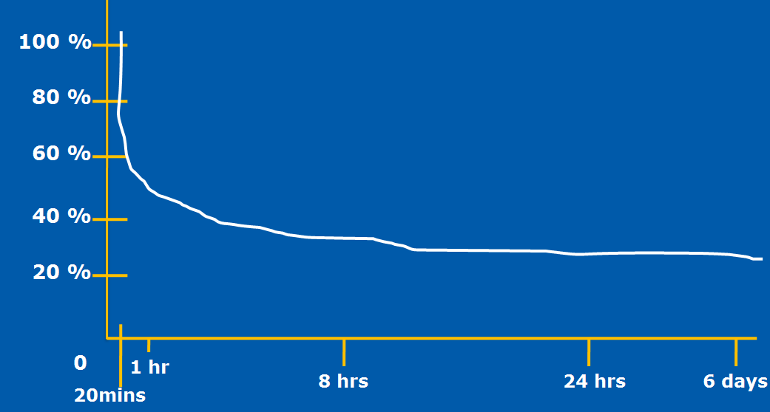
Why we forget
We remember information that had strong associations at the time we learnt it and / or is frequently used.
We are also very good at forgetting in everyday life – and we carry that across into learning.
The Forgetting Curve (Ebbinghaus, 1913)
Notes:
This is a famous chart illustrating the power of memory (researched by Ebbinghaus in 1913). It has been found that when people try to remember new sets of information, generally, the forget nearly half of it within an hour and then the rate of forgetting tails off. But depending on how important any information is, it typically rests somewhere down below 20-30%.
This is the norm, so we shouldn’t feel bad about forgetting things, because if we didn’t forget, we wouldn’t be able to focus on information that’s really important to us.
So in a paradoxical way, forgetting is an important skill that we should be proud of, as it allows us to not be stuffed up with random facts and information that we don’t need.
So rather than beating yourself up for not having the best memory, what we need to do is train our brain so it knows what it should remember.
One technique that is used to improve memory is called spaced recall, and it’s a strategy that doesn’t let the information disappear as it involves the regular review of information after it is learnt.
Hence, this is why it’s a good to finish off a study session by recalling the most important information that you’ve covered in a lecture or in a chapter that you’ve read, as it increases the capacity you have for remembering. Following up with a second review (maybe a day later), and third (a few days after that) also increases the amount of information that you’re able to remember. And so on.
Essentially, using this technique allows you to remember what you might naturally forget as it interrupts the natural decline of memory recall.
Main point: It’s human nature to want to move on after reading a chapter or going to a lecture, but in order to give your memory a clue that it needs to remember and not go into it default forgetting mode, you need to switch it on with an activity like spaced recall.

Slide 5
Spaced recall
One way to beat the forgetting curve is spaced recall – i.e. little and often
Building memory capacity typically relies on the strengthening of associations you make when first learning information – and that’s the main focus of the rest of this session
Notes:
In addition to spaced recall, you can actually strengthen the associations that you make with that new information and that gives you an even better chance of recalling it.
And that’s what we are going to focus on… [next slide]

Slide 6
MAKING STRONGER ASSOCIATIONS
An association connects two things:
A target word or fact
This is unfamiliar information – and at Uni, usually abstract and / or technical – which you are trying to learn
A hook
This is something familiar – typically physical – that you can link to the target word or fact so that you can recall it later

Slide 7
Visualisation
An effective way to create a hook is through visualisation:
Because it’s easier to remember pictures than words
And the mind cannot distinguish between what is real and what is imaginary
However, success is the result of recent, frequent and successful practice
Notes:
One way of giving your memory a hand, is to visualise. The mind works on associations between the abstract and the concrete.
Visualisation is one way of creating an almost physical link to abstract information.
So it’s a question of frequent and successful practice.
Steps to take for visualisation [next slide]

Slide 8






Steps to successful visualisation
Close your eyes
Relax
Create and manipulate sense impressions
Deepen and intensify
Suspend judgement
Practise often
Notes:
These are some steps you can take to make visualisation successful …

Slide 9
Example: Piaget’s 4 stages of cognitive development
For example, in Human Development, you may need to remember the four stages of cognitive development proposed by Piaget:
Sensorimotor (birth to two years)
Preoperational (two to seven years)
Concrete operational (seven to eleven years)
Formal operational (eleven years onwards)
Notes:
Here is some abstract information – Piaget’s model: four stages of development, which can be easily confused.

Slide 10

Piaget’s first stage: Sensorimotor
An association can be a more familiar word that sounds like the target word.
For example, for ‘sensorimotor’, I might think of a motor car on a pile of coins.
Then, I close my eyes and visualise the ‘hook’ I’ve made.

Slide 11
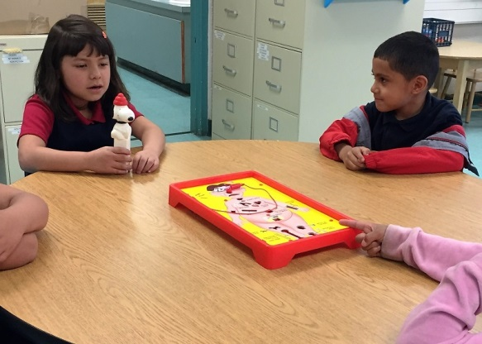
Piaget’s second stage: Preoperational
Task
Write in the chat box:
Your idea for a hook for the Piaget’s next stage:
Preoperational (two to seven years)
Feedback:
I thought of preschool kids playing the ‘Operation’ game
Notes:
What kind of an image might you use to remember this stage? Type in the chat box your idea
Note: The point here is to take some time to think about the word and associate it with an image, in order to help your mind remember it.

Slide 12
LINKING YOUR ASSOCIATIONS
In academic studies, we often need to learn sets or sequences of words or facts
Examples include:
Areas of the brain
Components of the marketing mix
Conditions for a legal contract
Write in the chat box:
One set or sequence of words or facts that it’s important to remember in a subject you are studying
Notes:
The idea is to talk more about how you can link associations to build up a kind of narrative that’s going to help you remember a set of facts.
Here are some examples of sets of facts and depending on your studies, you might need to learn component parts in a particular sequence…

Slide 13
3 Memory systems
There are a number of memory systems that can help you to remember sets or sequences of words or facts
We will look at:
  Acrostics
  Stories
  Loci (places)

Slide 14
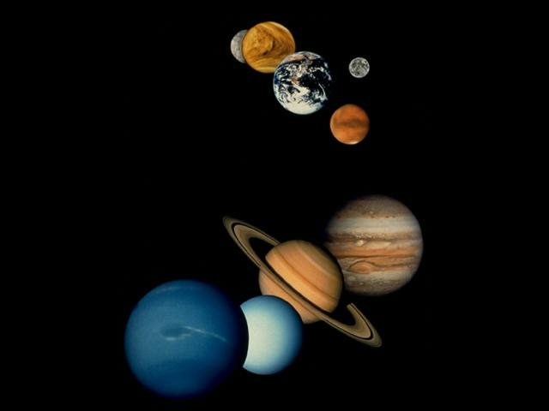
1. ACROSTICS
This is a simple system of making a sentence using the first letters of each word in a sequence.
Write in the chat box if you learnt the traditional one for the planets (including Pluto!):
Mercury
Venus
Earth
Mars
Jupiter
Saturn
Uranus
Neptune
Pluto
My
Vehicle
Encounters
Many
Jerks
Struggling
Up
Neglected
Paths
In this case, the ‘hooks’ are the words in the
sentence AND the sequence of the sentence itself.
Notes:
Acrostics involve taking the first letter of each word and making a sentence of them.
E.g.: Tradition ones:. every good boy deserves fruit EGBDF = order of musical notes.
Another acrostic for planets is: My Very Enthusiastic Mother Just Served Us Noodles
So the ‘hooks’ are the words in the sentence and the sentence itself helps us to remember the target, which is the planets in order.

Slide 15
Creating an acrostic
Task
Write in the chat box:
An acrostic for Piaget’s four stages of cognitive development:
Sensorimotor
Preoperational
Concrete operational
Formal operational
My example:
I came up with: Stages Piaget Cleverly Formulated
Notes:
Going back to Piaget’s four stages, can you think of an acrostic = four words that begin S P C F and make a little phrase or sentence.
It helps if you close your eyes and visualise it. You might say the sentence a few times and think about it how you can create a ‘hook’ sentence.
Because that sentence will then help you to remember the theoretical model.
Task: When you’re ready, just type in the chat box what you’ve come up with.
Here is one that my colleague came up with … Stages Piaget Cleverly Formulated
Which I think is quite good as it links to the original context.
NOTE: But you might like to use different strategies. For example, if I’m finding it particularly difficult to remember certain facts, I will assign an acrostic that is somewhat shocking … and it might include swear words. My Rationale For Doing This = it is an affront to my senses, which means that I am much more likely to remember it!

Slide 16
2. STORIES
This involves first making associations with words or facts and then making a story based on the original sequence. For example, if you need to memorise the most common elements (in order) found in rocks.
The first step is to make a ‘hook’ for each item in the list:
Oxygen = ox
Silicon = Pamela Anderson
Aluminium = aluminium foil
Iron = clothes iron
Calcium = calculator
Sodium = can of soda water
Potassium = pot
Magnesium = magnet
Notes:
You can use stories which have a natural built in order to remember information.
E.g. if you had to remember the most common elements found in rocks, and in order of frequency. Once you’ve done this, you would then think of a little story that begins with an ox … [next slide]

Slide 17
Making up a story with your hooks
Then you make up a story (as absurd as you like) involving the ‘hooks’ in sequence:
ox: an ox is walking along the road
Anderson: riding the ox is Pamela Anderson
aluminium foil: she is wearing a dress made from aluminium foil
clothes iron: the dress is rumpled, so she starts ironing it
calculator: a calculator falls out of the dress pocket
soda water: it falls down and lands next to a can of soda water
pot: the can of soda water is in a large iron pot
magnet: stuck on the side of the pot is a huge magnet
Close your eyes and visualise the story as you say it – and go over it a few times till you recall it.
Notes:
Again you can visualise this, where … You see an ox walking along the road etc…
You would then go over this a few times, visualising it, and what you’ve got is a story that’s really going to help you to remember those elements in the required order.

Slide 18
3. LOCI (PLACES)
When doing Loci, instead of a story, you visualise each ‘hook’ in a particular place as you follow a familiar route, like the rooms in your home, in a fixed order.
Bed 3
Bed 2
Toilet
Bed 1
Bathroom
Hallway
Kitchen
Dining Room
Garage
Lounge
Front door
Driveway
Notes:
And then the third way of learning sets of information is a traditional one, and goes all the way back to ancient Greece and Rome.
The idea being that you visualise a journey that you take often. It might be the journey that you take walking to work, or your journey through your home.
For example … [click to proceed through the house]

Slide 19
Using Loci to memorise the 12 cranial nerves
Let’s imagine you have to memorise the 12 cranial nerves…
olfactory optic oculomotor trochlear
trigeminal abducens facial auditory
glossopharyngeal vagus spinal accessory hypoglossal
The first step is to create visual ‘hooks’. Write in the text box if any spring to mind.
Here are some we prepared earlier!
olfactory = oil factory facial = face
optic = optician auditory = audio tape
oculomotor = motor car glossopharyngeal = lipgloss
trochlear = truck vagus = veggies
trigeminal = three gems spinal accessory = spine
abducens = duck hypoglossal = hypodermic needle
Notes:
With this method, lets imagine that you’ve got to remember the 12 cranial nerves = the olfactory, optic, oculomotor, trock-li-a, ab-duck-ens, glosso-fa-ringe-gel, etc…
As you can see, some of these words could be quite difficult to remember.
Again, we want to learn them in order.
So sort of similar to the Pamela Anderson story, you would want to create new hooks.
These are some examples that we’ve made up for this exercise.
Now let’s apply these to the map of our house [next slide]

Slide 20
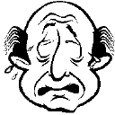




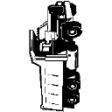
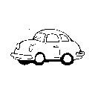
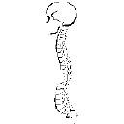



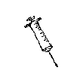
Applying the hooks to the home layout
Then you visualise one in each room as you go round the house
B3
B2
Hallway
Toilet
Bathroom
B1
Garage
Dining room
Lounge
Kitchen
Driveway
Kitchen
Notes:
So all we need to do is take a walk around our pre-prepared journey and each of those rooms we visualise the different hooks. So we go in and …. [click through 12 different rooms and images]
The trick is to make these memorable to YOU. For example, if I had to do this, My version would look very different: … [see next slide]

Slide 21

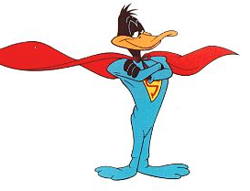

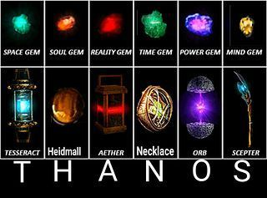

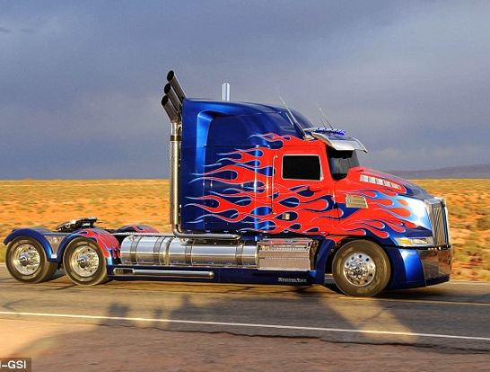
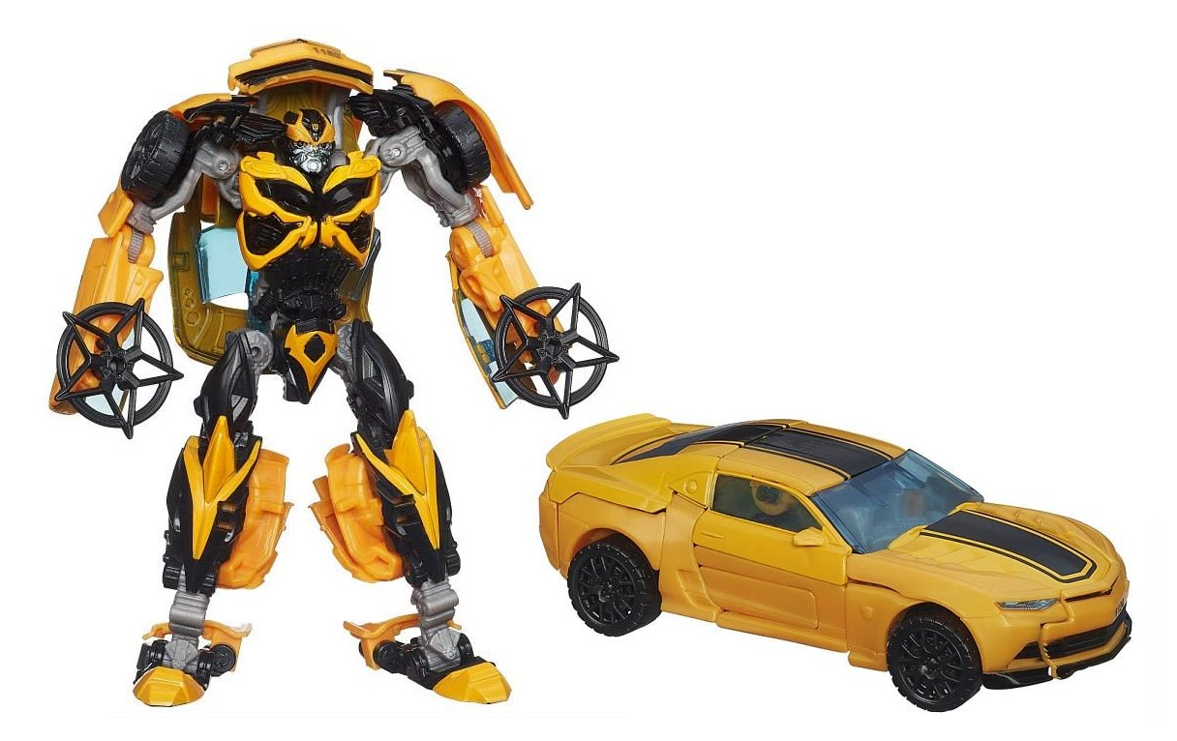

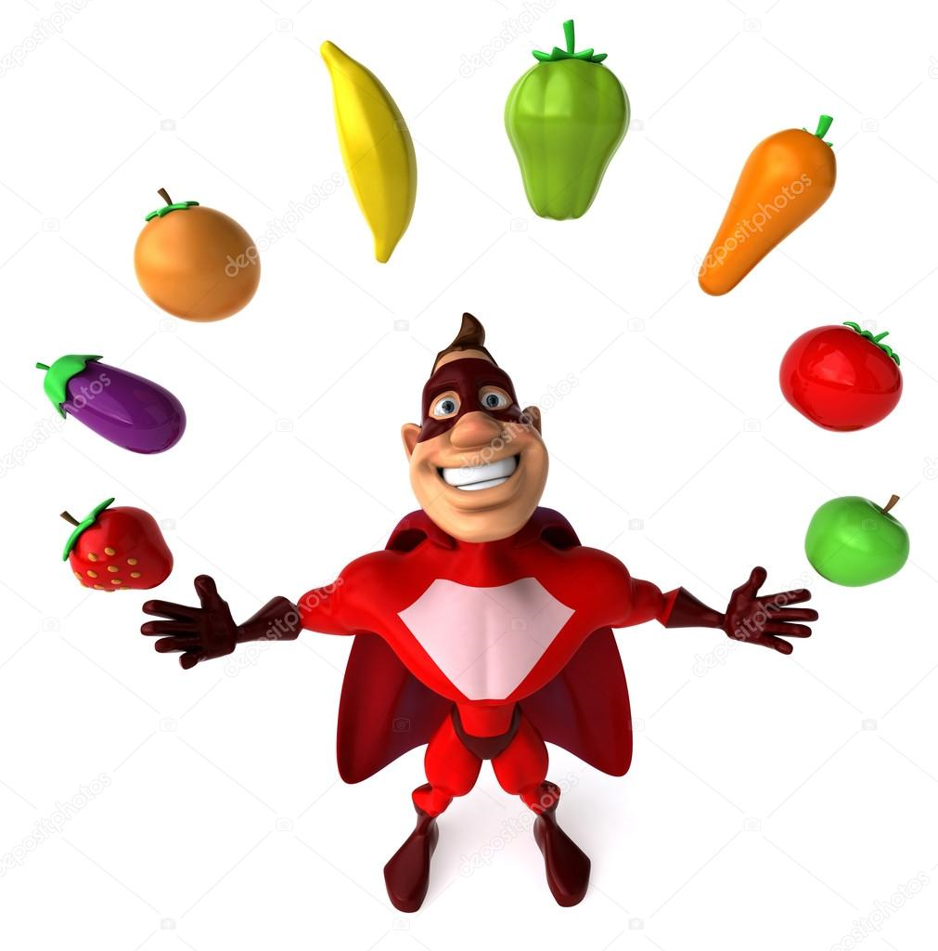



Alternative superhero themed hooks
Then you visualise one in each room as you go round the house
B3
B2
Toilet
Hallway
B1
Bathroom
Garage
Dining room
Lounge
Kitchen
Driveway
Front door
Notes:
Olfactory = Wolverine – (Xmen; enhanced sense of smell)
Optic = Cyclops - XMen
Oculomotor = bumblebee – Transformers
trochlear = Optimus Prime - Transformers
Trigeminal = Infinity gems – Marvel movies
Abducens = Super duck – Looney Toons
Facial = The Face – A-team
Auditory = DareDevil – Marvel movies
Glossopharyngeal = Gloss – Marvel comic book hero
Vagus = Super Vege Man
spinal accessory = Super Man – DC movies
Hypoglossal = #HypoHeroes – Website for World Diabetes Day
(Based off of movies and super heros)
These are examples of stories that take you along a predetermined journey, which get practiced a few times before they stick properly.
The point being that sets of facts like this are not just easier but more fun to learn when you use a strategy like this.

Slide 22
Final memory test
Can you recall?
The second most common element found in rocks
The third Piagetian stage of cognitive development
The first cranial nerve
Write your answers in chat:
Answers:
Silicon
Concrete operational
Olfactory

Slide 23
In this session you have learnt how to:
Summary
Use associations to reinforce learning and recall
Use memory systems to memorise sets of facts
For more advice and resources, look under ‘Academic Support’ on Stream
The library has several books on learning and memory. Use the search box or ask a librarian or learning consultant for advice.

Slide 24
Centre for Learner Success
Need help? We have a range of free services to help you with your assignment writing and study skills:
Individual Support: Want to discuss your assignment before you hand it in? Want to discuss study skills (e.g. how to manage time)? See next slide for booking information.
Pre-Reading Service: Submit a draft assignment and receive individual written feedback on your assignment’s structure, focus, referencing, and use of sources. This service is available to first year internal and all distance students. You can access the forum through the Academic Writing and Learning Support site on your Stream homepage.
Workshops: Seminars and workshops are run on campus and online, which can help you with writing and study skills, such as essay writing, referencing, and writing research proposals. See here for programmes and registration details. See http://owll.massey.ac.nz/about-OWLL/workshops.php
Academic Q+A forum: Ask our consultants a question about academic writing and/or study skills. The Q & A forum is a place for students to receive help with quick, study-related questions. You can access the forum through the Academic Writing and Learning Support site on your Stream homepage.
OWLL: Information about academic writing and study skills, including assignment planning, essays, reports, and referencing. Go to http://owll.massey.ac.nz/index.php
Disability Services: A range of services and support for students who have health and disability issues that are impacting their study.
Pasifika@Massey: Whether studying as an internal or distance student, you can also access Learning support from the Pasifika Learning Advisors.
Te Rau Tauawhi: Ko tä Te Rau Tauawhi he äwhina i ngä tauira Mäori ki te tuku aromatawatai ki Te Reo Mäori, ki te tautoko hoki i ngä ähuatanga whakarite tuhinga. The Te Rau Tauawhi Mäori Student Centre can help you to submit your assignment in Te Reo Mäori and provide general assignment structure support.

Slide 25
Contact information
Centre for learner success
Massey university
CAMPUS LOCATIONS:
Palmerston North - Manawatu: Centre for Learner Success
Student Centre Level 2, Manawatu Campus
Albany: Centre for Learner Success
Level 3, Library, Albany Campus
Wellington: Centre for Learner Success
Block 5, Ground Floor (Level A in the Library), Wellington Campus
Phone: + 64 6 951 6540
Email: learnersuccess@massey.ac.nz
We help students with…
Assignment writing advice
Academic writing development
Understanding assignment questions
Citing and writing references
Enhancing study skills, like:
  Reading techniques
  Notetaking
  Time management skills
  Critical thinking, reading & writing
TO BOOK AN APPOINTMENT,
GO TO:
https://massey-nz.libcal.com/

