Slide 1
STUDYUP:
KNOWLEDGE TO GO
How to write an essay
National Centre for Teaching and Learning

Slide 2
Writing an essay
What is an essay?
An essay is a written response to a particular question and outlines the author’s position on the issue in question
where the author stands on the issue

Slide 3
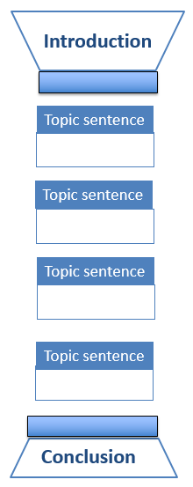
Essay structure
Set up context for your topic
Significance of broad topic
Focus in the essay
Main idea/argument (thesis statement)
10-15%
Body paragraphs support main argument
One main idea per paragraph
– expressed in topic sentence
Support main idea with evidence from literature – explanations, reasons etc.
Lead reader through argument - Connect sentences and paragraphs
Anchor each paragraph to Introduction by repeating key words in topic sentences
Come to logical conclusion
Summarise main ideas
Implications of what you’ve found
10%

Slide 4
Writing your essay
What are the steps involved?
Analyse question
Brainstorm topic
Research
Formulate thesis statement
Create outline
Write first draft
Revise and proofread

Slide 5
Analyse the question: TTF Method
Topic Task Focus
What are the Topic words
- what is the broad topic?
What are the Task words?
- Define? Analyse? Examine?
What is the Focus (Restrictions)?
- how is the topic narrowed
down?

Slide 6
Analyse the question: TTF Method
Example question:
Write a 1000-word essay on the definition of ‘female work’ in the twentieth century
Topic words (broad topic)?
Task word?
Focus?
‘female work’
define
twentieth century

Slide 7
Task words
Practise question:
In order to prevent workplace bullying, organisations need to look beyond issues of individual personality and examine how underlying organisational factors can contribute to the problem. Discuss.
Topic words (broad topic)?
Task word?
Focus?
workplace bullying
Discuss
(contribution of) individual personality
(contribution of) organisational factors

Slide 8
Analysing the question
Task word: Discuss
Following a statement or a quotation, this implies that a judgment about the statement or quotation is necessary:
- Do you agree or disagree with the
statement? Why?
- Do you agree partially? Why?
Indicate agreement/disagreement/partial agreement in thesis statement
Come to a conclusion on the issue. Does the evidence in the literature support the statement?

Slide 9
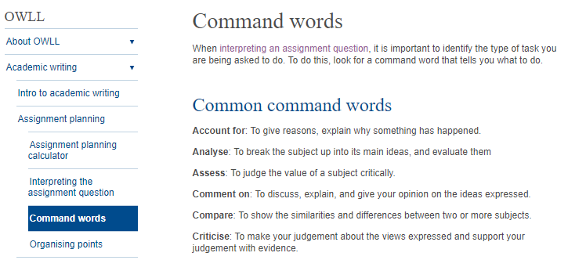
Analysing the question
Task word: Discuss
In order to prevent workplace bullying, organisations need to look beyond issues of individual personality and examine how underlying organisational factors can contribute to the problem. Discuss.
Does the evidence in the literature (your readings) support this statement?

Slide 10
Brainstorm before library search
What are the key questions that need answering?
Define your concepts
What is workplace bullying? Definition(s)
Why is it a problem?
Contribution of individual personality? How? Why?
Contribution of organisational factors?
Which factors? Why? How? Do they work in combination?
Given our understanding of factors, how can workplace bullying be prevented? Examples of successful implementation of measures?
Explain significance of problem: Effect on individuals/
organisations/society – evidence from literature
Key words/phrases for Library search

Slide 11
Researching the topic
Keep key questions in front of you – you’re searching for relevant information
Key questions | Article | My notes
Definition(s) of workplace bullying? Significance of problem? Individual factors? Organisational factors? Preventative measures? | Bentley et al. (2012)
Finding information:
Course materials
Books
Journal articles
Appropriate internet sites

Slide 12
Your voice guides the argument…
Writing the essay: Presenting an evidence-based argument
…a bit like a barrister in a legal case
Careful selection of relevant and reliable evidence to support your case – your argument
Presentation of your argument, using evidence to back up what you say
Introduce the issue → State your position → Defend your position
Notes:
Ok, so your voice should guide the argument you’re making, (click) a bit like a barrister in a legal case: You’re first going to be doing your research (click) and carefully selecting relevant and reliable evidence to support your case – your argument. You’re then going to be (click) presenting the argument, using the evidence to back up what you say. So (click) your voice guides the argument all the way though the assignment (click): You introduce the issue defining your terms and explaining the importance of the topic. You then state your position – your main argument on the topic, and then you defend your position. Now last year you learned about using your readings (the literature) to develop a basic argument in your assignment. This year (click)

Slide 13
Formulating a thesis statement
In order to prevent workplace bullying, organisations need to look beyond issues of individual personality and examine how underlying organisational factors can contribute to the problem. Discuss.
Sample thesis statement:
Issues with individual employees cannot be ignored in any attempt to analyse and address an organisation’s problem with workplace bullying. However it is crucial that the organisation also recognises and addresses organisational factors including A, B, C and D which may be enabling and even encouraging bullying behaviour.

Slide 14
Planning an outline
In order to prevent workplace bullying, organisations need to look beyond issues of individual personality and examine how underlying organisational factors can contribute to the problem. Discuss. 1500 words
average words per paragraph =
150 - 200
So for this essay, start off with a rough plan for ... 10 or 11 paragraphs

Slide 15
A plan for this essay might look like this …
1: Introduction: prevalence of workplace bullying; definition of bullying;
consequences of bullying: individual & organisational
10-15% of words
Thesis statement
2/3 : Factors with individual employees
What is the issue?
Why is it a problem – how can it lead to/encourage bullying?
What interventions can be used address it?
4/5 : Organisational factor 1
6/7 : Organisational factor 2
8/9: Organisational factor 3
10: Conclusion: combination of interventions needed to address
complex problem; future – research and practice
10% of words

Slide 16
When do you refer to the literature?
1: Introduction: prevalence of workplace bullying; definition of bullying;
consequences of bullying: individual & organisational
Thesis statement
2/3 : Factors with individual employees
4/5 : Organisational factor 1
6/7 : Organisational factor 2
8/9: Organisational factor 3
10: Conclusion: combination of interventions needed to address
complex problem; future – research and practice

Slide 17
Getting feedback
Learning Consultants at your campus CTL
- appointment required
Writing Consultants (Library)
- walk-in consultations
Pre-reading service – three day turnaround
Other students – honest opinions
Yourself – go back with fresh eyes
Albany: ctlalb@massey.ac.nz
Manawatu: ctlman@massey.ac.nz
Wellington: ctlwel@massey.ac.nz

Slide 18
Revising the assignment
ADD
What additional information is needed?
SUBTRACT
What information seems unnecessary?
MOVE
What information could be moved elsewhere?
CHANGE
What information needs changing?

Slide 19
Proofreading and editing your work
Spelling
Commonly confused words: (there/their/they’re; its/it’s)
Grammar Conventions: (commas, apostrophes, verb tense…)
Paragraphing: one idea per paragraph
Referencing: in-text and references page

Slide 20
How to write an essay
Summary
Analysis of the question
Research
Formulating the thesis statement
Creating an outline
Writing the first draft
Revising and proofreading

