Slide 1

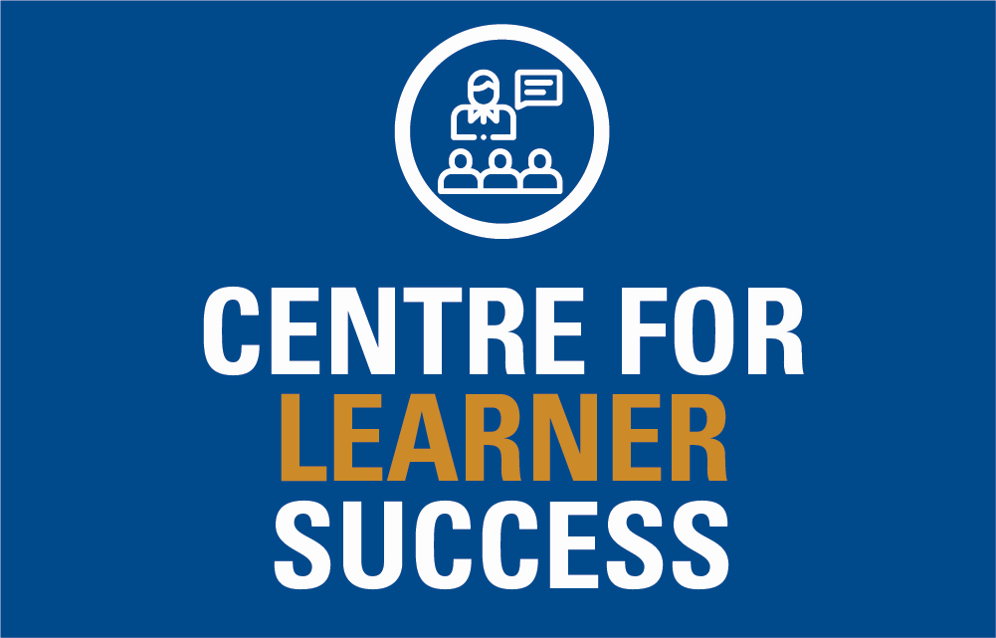
How to read effectively for study
National Centre for Teaching and Learning

Slide 2
Learning outcomes
By the end of this workshop, you should have a better idea how to:
Read with a purpose
Adjust your reading technique for purpose
Take notes

Slide 3
Reading myths
You need to read most of what’s on your reading list, starting at the top and working your way down.
All books and articles are well written and truthful.
You can’t really disagree with an academic text, because you’re not an expert.
Intelligent people only need to read things once

Slide 4
Stay awake – active reading
I pick up my textbook, but find myself daydreaming about what to have for dinner, or the tv show I watched last night…
Reading for study requires not just your eyes, it requires active effort that engages your brain.
Try active reading: techniques to help you concentrate and stay focused.

Slide 5

Active reading techniques
Have a clear purpose
  Why are you reading the book/article?
Adjust reading technique for purpose
  Scanning, skimming, close reading
Link back to what you already know
  How does it relate to what you’ve
  experienced/read?
Take notes
Finding a method that suits you
and the purpose

Slide 6
How do you know what to read?
Read with a purpose
Weekly study:
Understand course lecturer’s expectations
See Stream (text book chapters for that week, selected readings)
For assignments:
Understand assignment question
Start with relevant sections of textbook
List of readings
Consult lecture and tutorial notes

Slide 7
Taking control of your reading
Read with a purpose
Understanding assignment questions
What is the topic? What is the focus? What are you being asked to write about?
Use the essay question to guide your selection of readings.
Sample essay question:
To what extent is there a correlation between the levels of happiness experienced by cats, and the dog being made to sleep outside?
Broad topic: levels of happiness experienced by
Focus: the dog being made to sleep outside

Slide 8
Possible articles from your reading list
Which ones are relevant?
Parts will be relevant
Gibney, J., & Vorster, H. (2012). The psychology of cats and
dogs: An introduction. Blackwell.
Whitney, J. (2014). Levels of happiness in cats. The
International Journal of Pet Psychology, 1, 22-45.
McArdle, J., & Katch, M. (2018). The history of domestic pets
in Samoa. Penguin.
Looks directly relevant
Doesn’t look relevant

Slide 9
Searching for additional sources
Which ones would you use?
Graham, C. (2015, January 12). Why cats and dogs fight.
Australian Women’s Weekly, 21(1), 21-24.
Dog-cat relationship. (2019). http://en.wikipedia.org/
wiki/Relationships_between_cats_and_dogs
Frey, T., & James, B. (2020). Addressing levels of happiness and
aggression in felines and canines. Journal of Feline and Canine
Medicine and Surgery, 7(29), 1-2.
Dog, G. (2014). Why cats should be eliminated from the planet. . . . . . . . http://www.dogpreservationsociety.org/

Slide 10
Sources checklist
Read with a purpose
What type of source is it? (book, journal article, information from a website etc.)
Who wrote it and when?
Is it relevant, reliable and academic? (if not, is that ok?)
Why are you going to read it (what do you want to get out of it?)
a definition?
background information?
is some of it relevant for your argument?
is it a major theory/topic for your assignment/paper

Slide 11

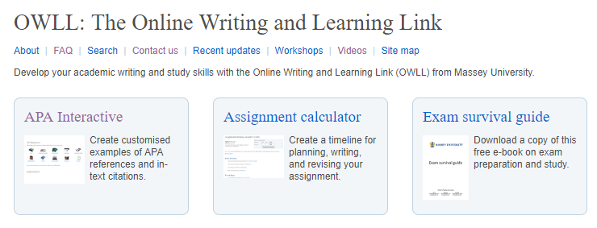
Take control of the reading list
Read with a purpose
Start with minimum, then think about:
  Do you need to clarify some ideas/learn more?
  How much time do you have?
  Assignment due in a few weeks?

Slide 12
How do you know how much to read?
Read with a purpose
Remind yourself:
Why are you reading this article?
Keep assignment questions in sight
Ask yourself:
How does it relate to your assignment?
  Does all of it relate, or just some of it?
Where will you find the information you need?
Do you need to scan it quickly, or read it thoroughly?
- Adjust reading technique to suit your purpose

Slide 13

Different ways to read:
Adjust reading technique to suit purpose
Scanning
Skimming (or gist reading)
Close reading (in-depth reading)

Slide 14
Scanning
  Looking over material quickly in order to pick out specific information
Why scan information?
  Browsing a database for texts
  Scanning a text for specific information
  Eg. A definition of a concept
  - Table of contents/Index
  - in the text
  - pdf documents: Ctrl f
  Looking back over material

Slide 15

Skimming (Gist reading)
Adjust reading technique to suit purpose
    Reading something quickly to get general idea of whole
    Books: Introduction, headings, subheadings
    Journal articles: Abstract
  Useful for:
  Deciding whether to read or reject a text
  Deciding whether to read in more detail
  Getting an overview to help with close reading

Slide 16


Close reading
Reading something in detail
To clearly understand the topic
To take notes and use information for an assignment
To take make notes for tests and exams

Slide 17
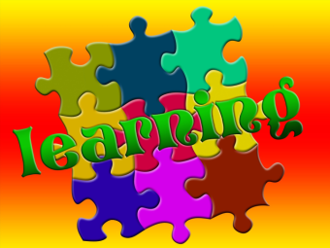
A few tips for close reading
Understand structure of different text types
- eg. journal articles, textbooks
Use reading aids in textbooks
- Learning outcomes
- Chapter summaries and questions
- Index and glossary
Use provided examples/cases
- there to help you understand
Consciously link new information to what you already know
- your own experience
- lecture notes, previous sections studied
- what you’ve read in the text already

Slide 18

Linking to what you’ve already read in a text
Close reading – reading for detail
Textbooks present knowledge in a cumulative way
- Any chapter/section prepares
you for the next chapter/
section
Go back in the text to move forward in understanding
- previous chapters, paragraphs,
sentences

Slide 19

Keeping track of information you’ve read
Taking notes:
Helps you remember
Helps you learn
Helps you stay awake while reading!

Slide 20

Experiment with different note-taking formats
Mind maps
Cornell method
Outlining method
Charting method
Study matrix
Annotated bibliography

Slide 21
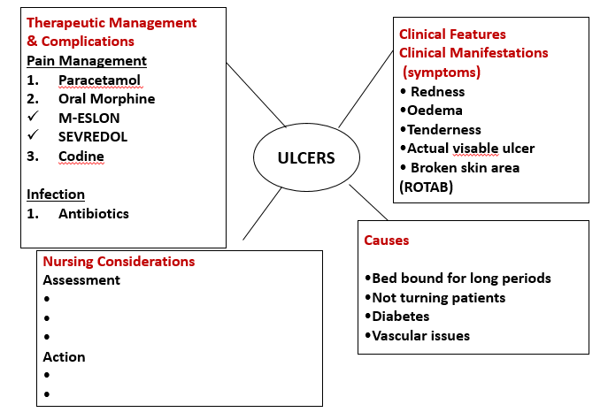
Mind map
Note-taking methods

Slide 22
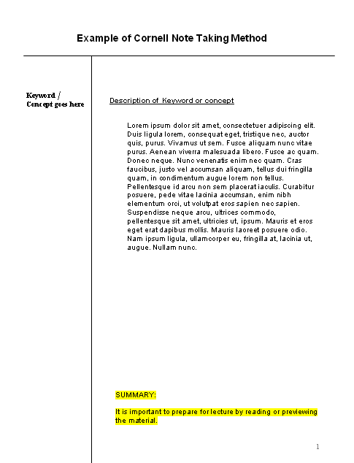
Cornell method
Note-taking method
Key word/
Concept
Description of key word/
concept
Your summary

Slide 23
Outlining method
Note-taking methods
Write a series of topics and sub-topics:
Main topic
Subtopic
Detailed point 1
Detailed point 2
Main topic 2
Subtopic
Detailed point 1
Detailed point 2
Use indenting, numbering or bulleting to identify levels of topic

Slide 24
Charts
Note-taking methods
Especially good for planning compare and contrast questions
3 basic issues | Piaget | Vygotsky
Continuous or discontinuous development? | Discontinuous – stages of development | Continuous – gradually acquire skills
One course of development or many? | One – stages are universal | Many possible courses
Nature or nurture most important? | Both nature and nurture | Both nature and nurture

Slide 25
Annotated Bibliography
Note-taking methods
For cross-referenced notes on individual readings
Thaman, K. H. (1994). Ecotourism-friendly or the new sell? One woman’s
view of ecotourism in Pacific Island countries. In A. Emberson-Bain
(Ed.), Sustainable development or malignant growth? Perspectives of
Pacific Island women (pp. 183-193). Marama Publications.
Argues that ....
Addresses ...
Recognises ...
Rejects ...
Advocates ...
A link to notetaking section in OWLL

Slide 26

Top tips for note-taking
Note-taking methods
When copying direct quotes make
them stand out
- use a different colour
- use obvious quotation marks
Avoid highlighter syndrome
- passive reading
Work with others in reading, understanding and taking notes

Slide 27
Before lectures:
Read set readings
Preview appropriate sections of textbook/study guide
- Headings
- Introduction
- Key concepts (may appear as margin notes)
- Diagrams
- Chapter summaries
Note down key topics/ideas found
Mentally re-run previous lecture

Slide 28
Summary
Read actively (not passively)
Have a clear purpose when you read
Adjust your reading technique according to your purpose
Take notes

Slide 29
Need help?
We have a range of free services to help you with your assignment writing and study skills
Individual Support: Want to discuss your assignment before you hand it in? Want to discuss study skills (e.g. how to manage time)? Book an appointment at massey.ac.nz/ctlcontacts or drop in.
Pre-Reading Service: Submit a draft assignment and receive individual written feedback on your assignment’s structure, focus, referencing, and use of sources. This service is available to first year internal and all distance students. You can access the forum through the Academic Writing and Learning Support site on your Stream homepage.
Workshops: Seminars and workshops are run on campus and online, which can help you with writing and study skills, such as essay writing, referencing, and writing research proposals. See here for programmes and registration details. See http://owll.massey.ac.nz/about-OWLL/workshops.php
Academic Q+A forum: Ask our consultants a question about academic writing and/or study skills. The Q & A forum is a place for students to receive help with quick, study-related questions. You can access the forum through the Academic Writing and Learning Support site on your Stream homepage.
OWLL: Information about academic writing and study skills, including assignment planning, essays, reports, and referencing. Go to http://owll.massey.ac.nz/index.php
Disability Services: A range of services and support for students who have health and disability issues that are impacting their study.
Pasifika@Massey: Whether studying as an internal or distance student, you can also access Learning support from the Pasifika Learning Advisors.
Te Rau Tauawhi: Ko tā Te Rau Tauawhi he āwhina i ngā tauira Māori ki te tuku aromatawatai ki Te Reo Māori, ki te tautoko hoki i ngā āhuatanga whakarite tuhinga. The Te Rau Tauawhi Māori Student Centre can help you to submit your assignment in Te Reo Māori and provide general assignment structure support.
learnersuccess@massey.ac.nz

